Slide 1

Privacy TOOLS FOR SHARING RESEARCH DATA
NSF site visit
October 19, 2015
Salil Vadhan
Supported by the NSF Secure & Trustworthy Cyberspace (SaTC) program, the Sloan Foundation, and Google.

Slide 2
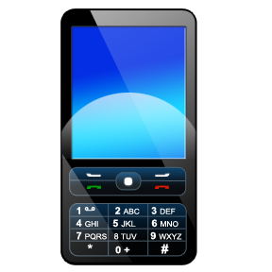
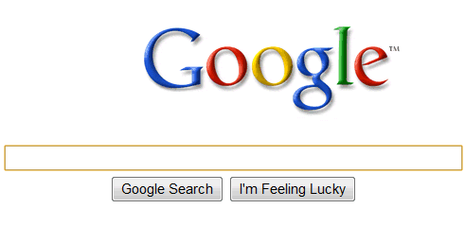


Computational Social Science
The potential: massive new sources of data and ease of sharing will revolutionize social science.
The problem: protecting the privacy of individual subjects
utility
traditional approaches
(e.g. “stripping PII”)
privacy
open data
privacy
e.g. NYT 5/21/12 “Troves of Personal Data, Forbidden to Researchers”
Notes:
The context for our project is the exciting transformation that is happening in social science, due to the immense variety and volume of new sources of data on human behavior. Instead of being limited to surveys of a few thousand people, researchers can carry out studies on the scale of hundreds of thousands by using data from new sources such as cell phone GPS readings, web searches, political blog posts, and social network activity. Moreover, the internet and data repositories such as the Dataverse Network (which I’ll talk about later) have made it much easier to share such data with other researchers enable replication and new analyses.
However, a major obstacle for realizing the full potential of this vision is Privacy. Most of these datasets contain sensitive personal information about individuals, and currently social scientists do not have the tools to ensure that the privacy of those individuals is protected when the data is analyzed or shared. The result is that researchers are refusing to share their data, clashing with the growing movement towards open sharing of data being pushed by the research community and funding agencies.
What do about this? The traditional approach is to try and anonymize data by removing so-called “personally identifying information”. However, it is now well-known that this technique does not work, because moderate amounts of seemingly innocuous information can already uniquely isolate individuals, and this information can often be linked with other publicly available data to re-identify the individuals in supposedly anonymized datasets. This problem was demonstrated in work by my co-PI Latanya Sweeney a number of years ago linking anonymized medical claims data with public voter registration rolls to uniquely identify the record of Massachusetts governer William Weld, and has become much more acute with the vast amounts of data that is publicly available on the internet. Indeed, there have been many more examples of reidentifications since then.
Thus, this traditional approach presents us with a stark choice between privacy and data utility. If you remove only obviously identifying information, then the privacy is very weak – you’ve just made it slightly harder to identify individuals. If you aggressively de-identify, then the resulting dataset may have very little utliity left – you may have removed exactly the information you are interested in studying.

Slide 3
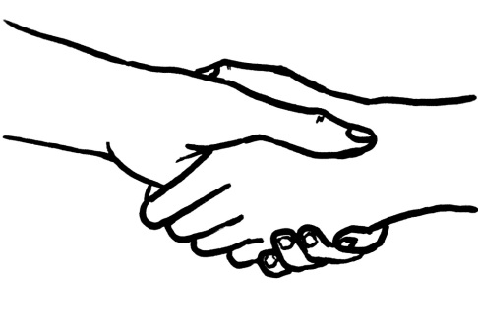
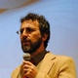
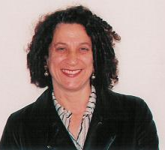
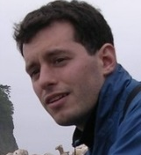


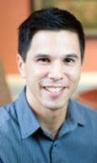
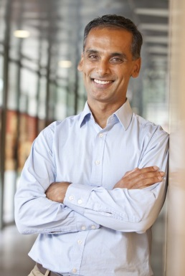
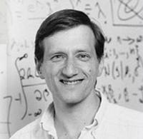




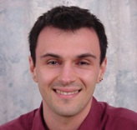
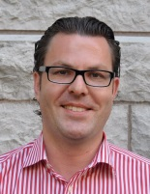
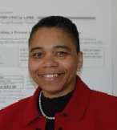


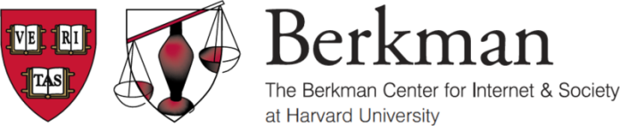




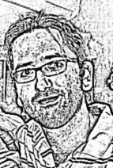
Our Goal
utility
Achieve:
privacy
&
open data
Dwork
(MSR)
Smith
(PSU)
Nissim
(BGU)
Altman
(MIT)
privacy
Via:
social
science
Honaker
Chong
Vadhan
King
Crosas
computer
science
statistics
Gasser
Sweeney
Airoldi
Gaboardi
(Dundee)
law &
policy
Kantarcioglu
(UTD)
O’Brien
Hurley

Slide 4
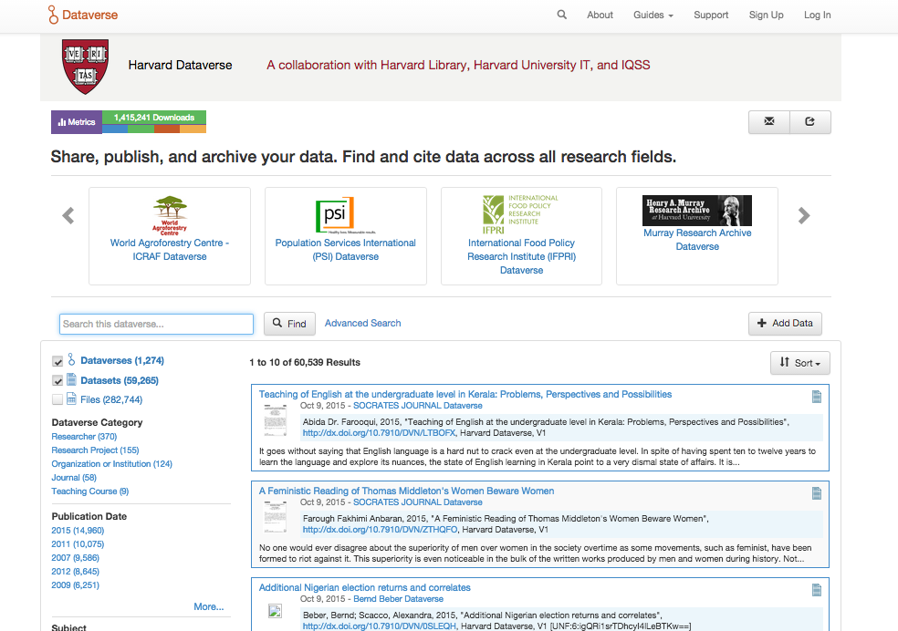
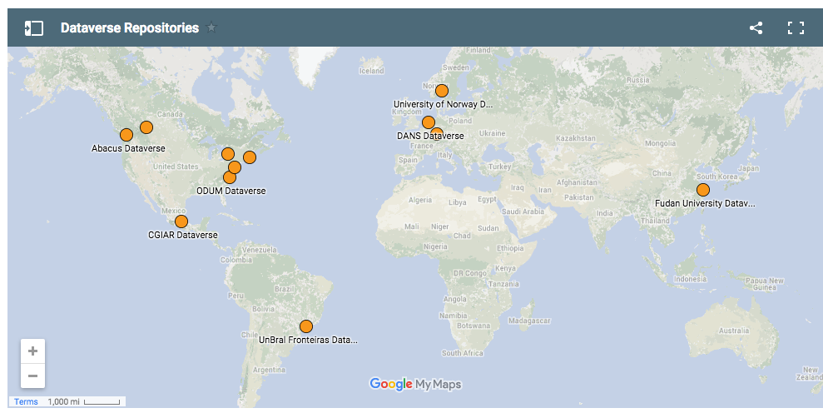
Use Case: Data Repositories
Harvard Dataverse Repository:
1274 dataverses with 59,265 datasets
and 1,415,241 downloads
Largest social science repository in the world
Dataverse Repositories around the world:
12 repositories in production with research data
~10 under construction
Notes:
Stress = wide use of datavsrse. 10 repositories around the world, ¾ million files. Harvard dataverse has served 1m+ downloads.
NEED TO UPDATE SCREENSHOT.

Slide 5
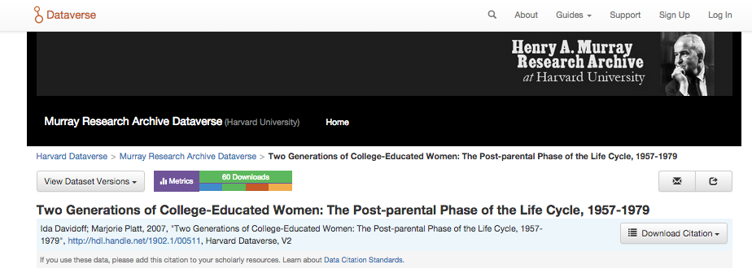
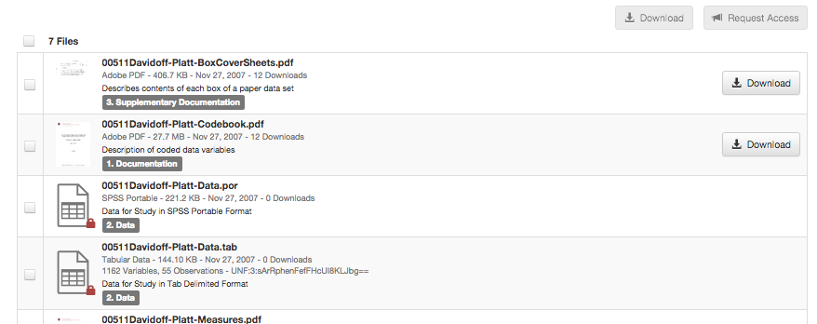
Datasets are restricted due to privacy concerns
Goal: enable wider sharing while protecting privacy

Slide 6
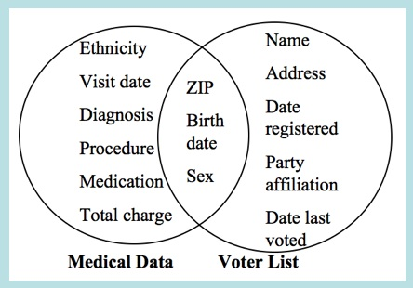
Challenges for Sharing Sensitive Data
Complexity of Law
Thousands of privacy laws in the US alone, at federal, state and local level, usually context-specific:
HIPAA, FERPA, CIPSEA, Privacy Act, PPRA, ESRA, ….
Difficulty of Deidentification
Stripping “PII” usually provides
weak protections and/or poor utility
Inefficient Process for Obtaining Restricted Data
Can involve months of negotiation between institutions, original researchers
Goal: make sharing easier for
researcher without expertise in
privacy law/cs/stats
Sweeney `97
Notes:
This is the challenge. General-purpose environment.

Slide 7
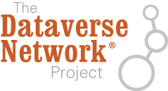
Vision: Integrated Privacy Tools
Risk Assessment and
De-Identification
Open Access to
Sanitized Data Set
Deposit in repository
IRB proposal & review
Consent from subjects
Data Set
Data Tag Generator
Differential Privacy
Query Access
Policy Proposals and Best Practices
Database of Privacy Laws & Regulations
Customized & Machine-Actionable
Terms of Use
Restricted Access
Tools we are working on
Notes:
Stress that while this is a focusing vision, our work in each area also stands alone.

Slide 8
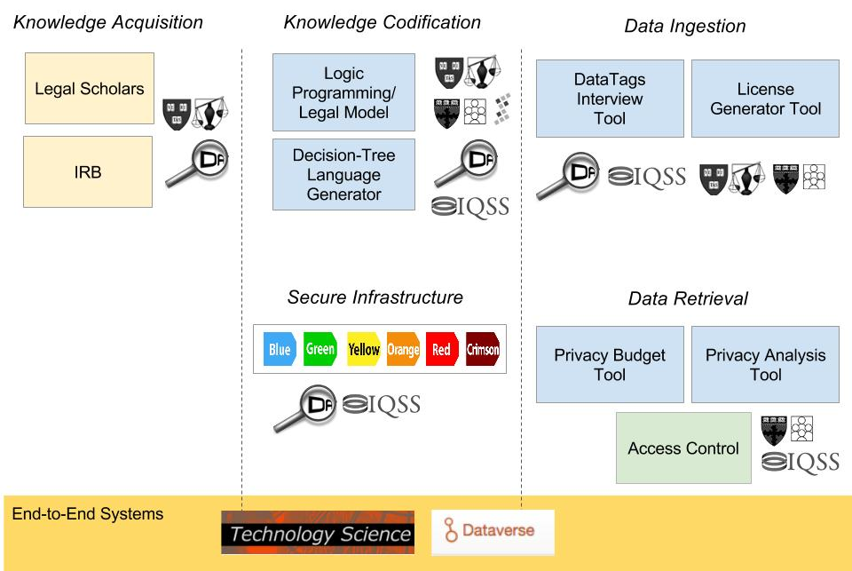
DataTags Ecosystem with Collaborations

Slide 9
This Site Visit: Depth over Breadth
Short presentations of specific works to illustrate:
  Cross-disciplinary collaboration
  Involvement team members from PIs to students
  Knowledge transfer and outreach
No attempt to survey everything we are doing
  E.g. papers in FOCS, SODA, COLT, CSF, ICALP, …
  See annual report and project website.
  Please ask if you’re wondering!

Slide 10
Agenda I
Privacy Tools for Social Science
Gary King (IQSS)
A Differentially Private Curator Tool
& Supporting Theoretical Work
James Honaker (IQSS)
Kobbi Nissim (CRCS)
DataTags: The Vision & Implementation
in Technology Science
Latanya Sweeney
(Data Privacy Lab, IQSS)
Logic Programming for Data Tagging
Stephen Chong (CRCS)
CS | Soc Sci | Stats | Law | Policy
CS | Soc Sci | Stats | Law | Policy

Slide 11


Agenda II
Education & Outreach
Salil Vadhan (CRCS)
Urs Gasser (Berkman)
Lunch & Poster Session with Students & Postdocs
Modern Framework for Privacy Analysis
& Government Open Data
David O’Brien (Berkman)
Alexandra Wood (Berkman)
Bridging Notions of Privacy in CS, Law, Social Science
Kobbi Nissim (CRCS)
CS | Soc Sci | Stats | Law | Policy
CS | Soc Sci | Stats | Law | Policy
CS | Soc Sci | Stats | Law | Policy

Slide 12

Agenda III
Summary & Future Plans
Salil Vadhan (CRCS)
Transition to Practice
Merce Crosas (IQSS)
NSF Private Discussion
Feedback
CS | Soc Sci | Stats | Law | Policy
CS | Soc Sci | Stats | Law | Policy

