Slide 1

EDUCATION & OUTREACH
NSF site visit
October 19, 2015
Salil Vadhan and Urs Gasser
Supported by the NSF Secure & Trustworthy Cyberspace (SaTC) program, the Sloan Foundation, and Google.

Slide 2
Overarching Goals
Exposing a multidisciplinary understanding of data privacy to a wide range of audiences (students, policymakers, public)
Bringing integrated solutions to data privacy problems to practice (focusing on data repositories and computational social science)

Slide 3
Activities
Training students & researchers
Development of courses & educational materials
Outreach to general public
Open resources
Policy engagement and commentary
Engagement with stakeholders

Slide 4
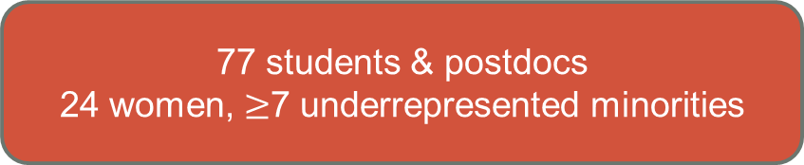
Training Students & Researchers
Post-Project Position
2
7 grad
school
3
postdoc
2
5 faculty/
researcher
10
industry
4
non-profit
6
gov’t
1
1
2
1
Project Position
3
5
6
3
1
1
1
1
2
1
2
77 students & postdocs
24 women, $≥$7 underrepresented minorities
19 summer
undergrad
4
11 term-time
ugrad
1
15 grad
student
1
13 postdoc/
fellow
10 term-time
law
12 summer
law intern
7
1
12
12
1
1
7
3
4
8
3
1
12
6
14 Harv.
ugrad
15 non-H.
ugrad
5 Harv.
grad
14 non-H.
grad
3 non-H.
postdoc
13 Harv.
law
13 non-H.
law
Pre-project Position

Slide 5
Summer 2015 Intern Experience
Students from CS (6), Social Science (4), and Law (3)
Project-wide orientation at start of summer
  For all students, from all units: CRCS, Berkman, IQSS/Dataverse
  Tutorial videos on online
Continued tutorials throughout summer
  Differential privacy, R, Statistics
  Many taught by students, postdocs, and visitors
Cross-disciplinary mentoring
Continued project-wide activities
  All-hands meetings
  Kickball game and project retreat (repeating Spring term retreat)

Slide 6
Typical Summer Meeting Attendance
 | Computer Science |  |  |  | Social Science/ IQSS/Stats |  |  | Law
 | Sr. | Pdoc | PhD | Ugrad | Sr. | Pdoc | Ugrad | Sr. | Pdoc | Grad
All-hands | 3 | 1 | 3 | 4 | 2 | 1 | 4 | 1 | 1 | 3
Diff. Priv. | 3 | 1 | 3 | 4 | 1 | 1 | 4 | 0 | 0 | 0
Bridging Notions | 3 | 1 | 3 | 1 | 1 | 0 | 2 | 1 | 1 | 3
* Not based on rigorous data collection.

Slide 7
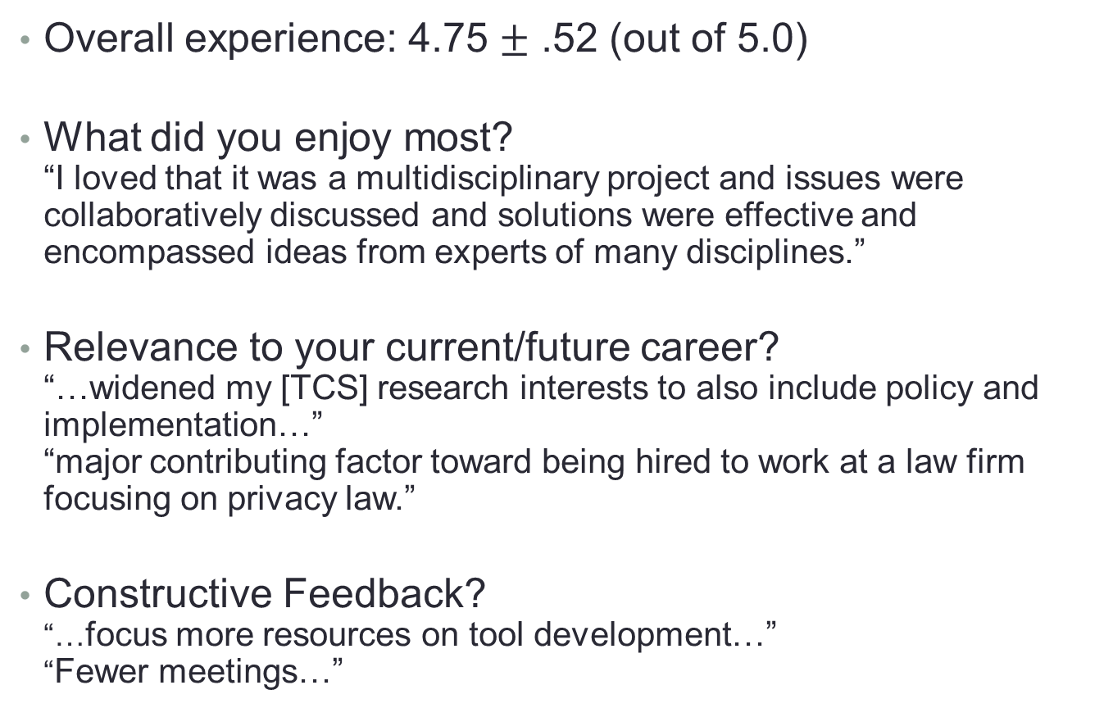
Survey of Project Participants
Overall experience: 4.75 $±$ .52 (out of 5.0)
What did you enjoy most?
“I loved that it was a multidisciplinary project and issues were collaboratively discussed and solutions were effective and encompassed ideas from experts of many disciplines.”
Relevance to your current/future career?
“…widened my [TCS] research interests to also include policy and implementation…”
“major contributing factor toward being hired to work at a law firm focusing on privacy law.”
Constructive Feedback?
“…focus more resources on tool development…”
“Fewer meetings…”

Slide 8
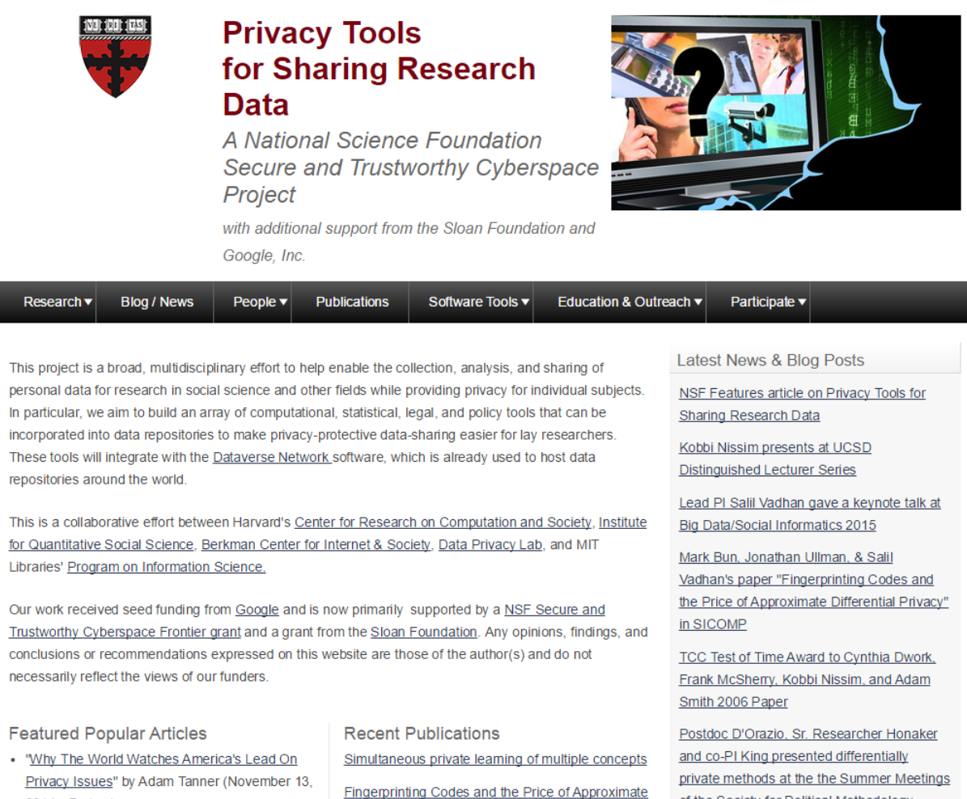
Project website
Update and replace with actual link that I can follow to show them things

Slide 9
Outreach to General Public
Over 700 registrants
Videos online

Slide 10
Outreach to Social Science
First Dataverse Community Meeting, June 2015.
  Presentations & Break-Out Sessions on Privacy, incl. DataTags
Conference Presentations
  Meetings of the Midwest Political Science Association
  Summer Meetings of the Society for Political Methodology
  Annual Meetings of the American Political Science Association.
  Society of Economic Measurement OECD conference.
Paper “Automating Open Science for Big Data” by Crosas-King-Honaker-Sweeney in a special Big Data issue of The ANNALS of the American Academy of Political and Social Science.

Slide 11
Outreach to Legal & Policy Communities
Goal: Transferring project findings and insights from technical literature to lawyers and policymakers
Deep interdisciplinary collaborations within the project
  Developing real-world data privacy use cases
  Contextualizing findings from scientific research on privacy
  Identifying gaps in current regulatory and procedural approaches
  Devising new analysis frameworks and policy recommendations for addressing gaps
Highlights from Year 3: joint publications, presentations, meetings & workshops

Slide 12




Outreach to Legal & Policy Communities
Approach
Theoretical research on privacy
Policymakers
Synthesis, Analysis & Application
Re-identification literature
Legal scholars
Identifying gaps in current approaches
Formulating policy recommend-ations
Practicing lawyers
Real-world
privacy practices
Law students

Slide 13
Outreach to Legal & Policy Communities
Highlights
EU communities
Theoretical research on privacy
Policymakers
Synthesis, Analysis & Application
Re-identification literature
Legal scholars
Identifying gaps in current approaches
Formulating policy recommend-ations
Practicing lawyers
Real-world
privacy practices
Law students
Perspectives on the Future of Digital Privacy
Article

Slide 14
Outreach to Legal & Policy Communities
Highlights
Theoretical research on privacy
Policymakers
Synthesis, Analysis & Application
Legal & ethics
scholars
Re-identification literature
Identifying gaps in current approaches
Formulating policy recommend-ations
Practicing lawyers
Real-world
privacy practices
Law students
Strictly Biomedical? Sketching the Ethics of the Big Data Ecosystem in Biomedicine
Article

Slide 15
Outreach to Legal & Policy Communities
Highlights
Theoretical research on privacy
Policymakers
Synthesis, Analysis & Application
Legal & ethics
scholars
Re-identification literature
Identifying gaps in current approaches
Formulating policy recommend-ations
Practicing lawyers
Real-world
privacy practices
Law students
When Is Information Purely Public?
Article

Slide 16
Outreach to Legal & Policy Communities
Highlights
Theoretical research on privacy
Policymakers
Synthesis, Analysis & Application
Re-identification literature
Legal scholars
Identifying gaps in current approaches
Formulating policy recommend-ations
Practicing lawyers
Real-world
privacy practices
Law students
& General public
Internet Monitor Report: Reflections on the Digital World
Essays & Medium Stories

Slide 17
Outreach to Legal & Policy Communities
Highlights
Theoretical research on privacy
Policymakers
Synthesis, Analysis & Application
Re-identification literature
Legal scholars
Identifying gaps in current approaches
Formulating policy recommend-ations
Practicing lawyers
Real-world
privacy practices
Law students
Rethinking Privacy in an Era of Big Data, IoT, and Nudge
Student-led Mini-symposium

Slide 18
Outreach to Legal & Policy Communities
Highlights
Theoretical research on privacy
Policymakers
Synthesis, Analysis & Application
Re-identification literature
Legal scholars
Identifying gaps in current approaches
Formulating policy recommend-ations
Practicing lawyers
Real-world
privacy practices
Law students
Towards a Modern Approach to Privacy-Aware Government Data Releases
Article & Presentation at Berkeley Symposium

Slide 19



Outreach to Legal & Policy Communities
Future Plans
  NYU-Berkeley Conference on Responsible Use of Open Data: Government and the Private Sector (November 2015)
  Presentation on our open data article
  Berkman Luncheon Series Talk (CRCS+Berkman)
    Bridging Legal and Computer Science Approaches to Privacy (November 2015)
  Big Data, Health Law, and Bioethics Conference (May 2016)

