Slide 1

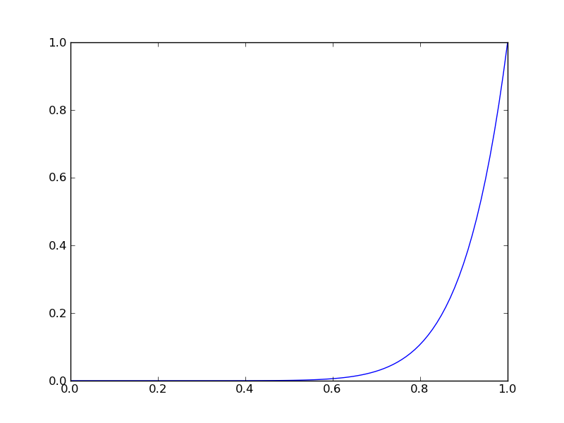
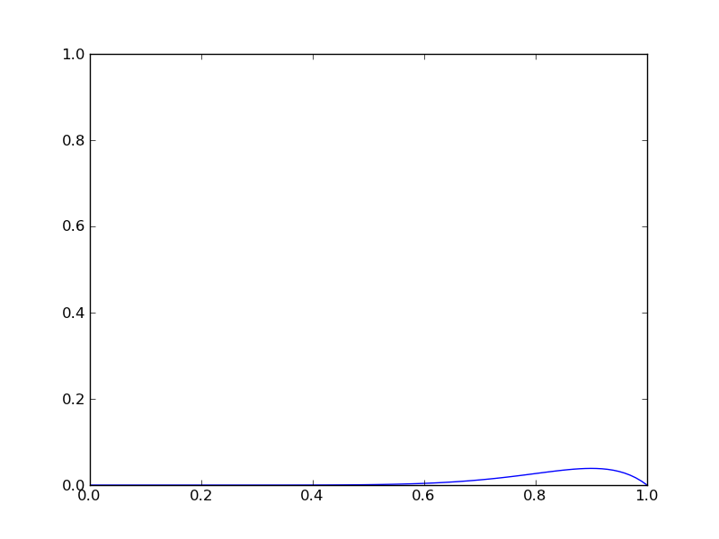
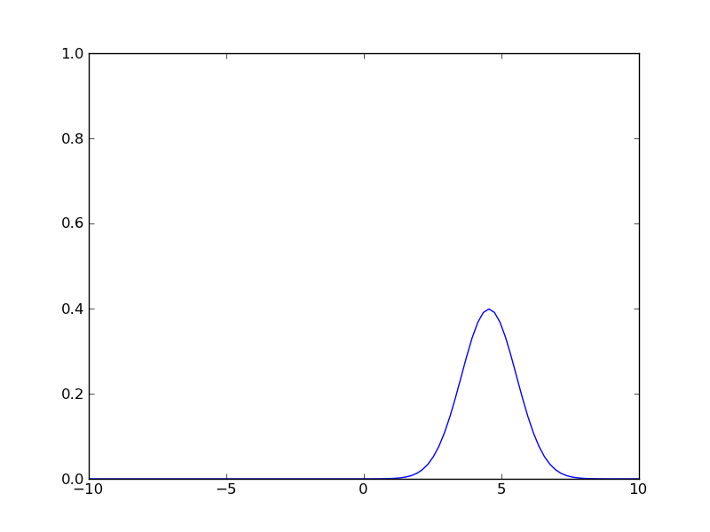
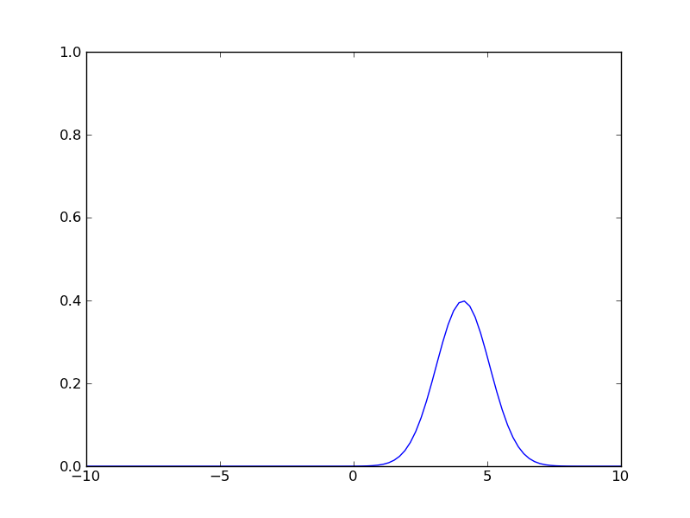




Differential Privacy of Bayesian Inference
Joy Zheng, advised by Salil Vadhan
Undergraduate Researcher (Harvard College ‘15)
Motivation
Bernoulli/Binomial Distributions
Normal Distributions
Conclusions
Do Bayesian inference and related methods of synthetic data generation in statistics satisfy differential privacy?
While various differential-privacy specific methods for calculating statistical values have been developed [DL08, Smith08], we are interested in the degree to which standard techniques in statistics already fit the definition of differential privacy.
In particular, given that these techniques already involve:
randomness via sampling from various distributions
boiling down the dataset into a small number of (summary) parameters
they raise the possibility that we already get some privacy by default.
The data set X is in {0,1}^{n}.
The parameter θ is a real number in [0,1], and gives the probability that any given data point of X is equal to 1.
The prior Θ is Beta(α,β), which is the conjugate prior distribution for the binomial; this can be interpreted as us having seen α-1 prior instances of a 1 and β-1 prior instances of a 0.
Results:
II is not ε-differentially private.
Probability density functions of θ|X for an extreme example of neighboring data sets X=1¹⁰ and X=(1, 0⁹), respectively. As we can see, the probabilities vary dramatically between these two data sets.
There exists c where II is (ε, δ)-differentially private if
Key point: the condition for ε-differential privacy is satisfied so long as the value of θ drawn lies close to its expectation. So long as α,β are large enough that we have seen a reasonable number of examples of both 0’s and 1’s in our prior and data, then the probability that θ is drawn far away from its expectation is exponentially small in the distance.
There exists c where III is ε-differentially private if
where m is the number of synthetic data points drawn.
There exists c where IV is ε-differentially private if
If θ is not redrawn for each synthetic data point, then this is also a lower bound on the strength of the prior distribution needed to achieve privacy.
There exists c, c₁ where IV is (ε, δ)-differentially private for sufficiently large n and c₁n synthetic data points if
where θ is redrawn for each synthetic data point.
The data set X is in [-R,R]^{n} for some real number R.
(If the data points are allowed to be unrestricted real numbers, then we effectively cannot obtain either ε or (ε, δ)-differential privacy.)
The parameters θ=(μ,σ²) are real numbers, of which σ² is known while μ is unknown.
The (conjugate) prior Θ on μ is another normal distribution N(0,σ₀²).
Results (preliminary):
II is not ε-differentially private if we allow μ to be unrestricted.
There exists c where II is ε-differentially private if we restrict μ to [-R,R] and
There exists c where II is (ε, δ)-differentially private if
Neither III nor IV are (ε, δ)-differentially private.
There exists c where III and IV are ε-differentially private for a single synthetic data point z if we restrict z to [-R,R] and
The probability density functions for z in the cases of neighboring data sets X=(R¹⁰) and X=(-R, R⁹) with R=5 and σ=σ₀=1. The log-ratio of these two density functions is actually a linear function of z, which explains why we cannot achieve ε-differential privacy without restricting z.
There exists c where III and IV are (ε, δ)-differentially private for sufficiently large n if we restrict z to [-R,R] and
So far, the randomness involved in inference seems to provide privacy in some cases for the two distributions examined, with the bounds being polynomial in the relevant privacy parameters of 1/ε and ln(1/δ).
Generating synthetic data in these two cases appears more private than releasing the parameter, shown by the looser bounds on parameters needed to satisfy privacy.
Some commonalities between the two distributions are:
  We tend to lose ε-differential privacy whenever the parameter drawn lies far away from its expectation.
  The range of “good” parameters decreases with the size of the data set, but the probability that it lies far away also decreases.
However, it is not clear how the restrictions we needed to achieve privacy in the case of a normal distribution could be applied to other distributions.
Moving forward, the goal is to generalize these results; we would like to pull out characteristics of the distributions which imply privacy, as has been done for a variant of differential privacy [DNMR 13].
Differential Privacy
An algorithm A is (ε, δ)-differentially private if for all neighboring data sets X, X’ which differ on only one data point, and for all sets S of outputs,
Inference Algorithms
Important parameters:
A data set X of n points, whose points are numbers in some range
The points are assumed to be drawn independently from some distribution D(θ), with θ unknown
There is a prior distribution Θ(θ₀) for θ, parameterized by value(s) θ₀
When we generate synthetic data, we do so by first determining a value of θ, and then drawing data points from D(θ). Unlucky draws of θ can be guarded against in IV (below) by drawing multiple values of θ and generating a few synthetic data points based upon each one.
We look at four types of information releases:
X
θ
D(θ)
Synthetic Data
References
[DL08] Dwork, C. and Lei, J. (2008). Differential privacy and robust statistics. In Proceedings of the 41st Annual ACM Symposium on Theory of Computing (STOC).
[DNMR 13] Dimitrakakis, C., Nelson, B., Mitrokotsa, A., and Rubinstein, B. (2013). Robust, secure, and private Bayesian inference. Available at http://arxiv.org/abs/1306.1066.
[RRR 03] Raghunathan, T.E., Reither, J.P., and Rubin, D.B. (2003). Multiple imputation for statistical disclosure limitation. Journal of Official Statistics 19(1):1-16.
[Smith08] Smith, A. (2008). Efficient, differentially private point estimators. Available at http://arxiv.org/abs/0809.4794.
 |  | Generation of θ
 |  | Most likely value | Drawn from the posterior θ|X,θ₀
Information released | θ only | I (never differentially private, because it is deterministic, but differentially private estimators exist [Smith08]) | II
 | Synthetic data | III | IV (known as multiple imputation [RRR 03])
Contact
shijiezheng@college.harvard.edu

