Slide 1

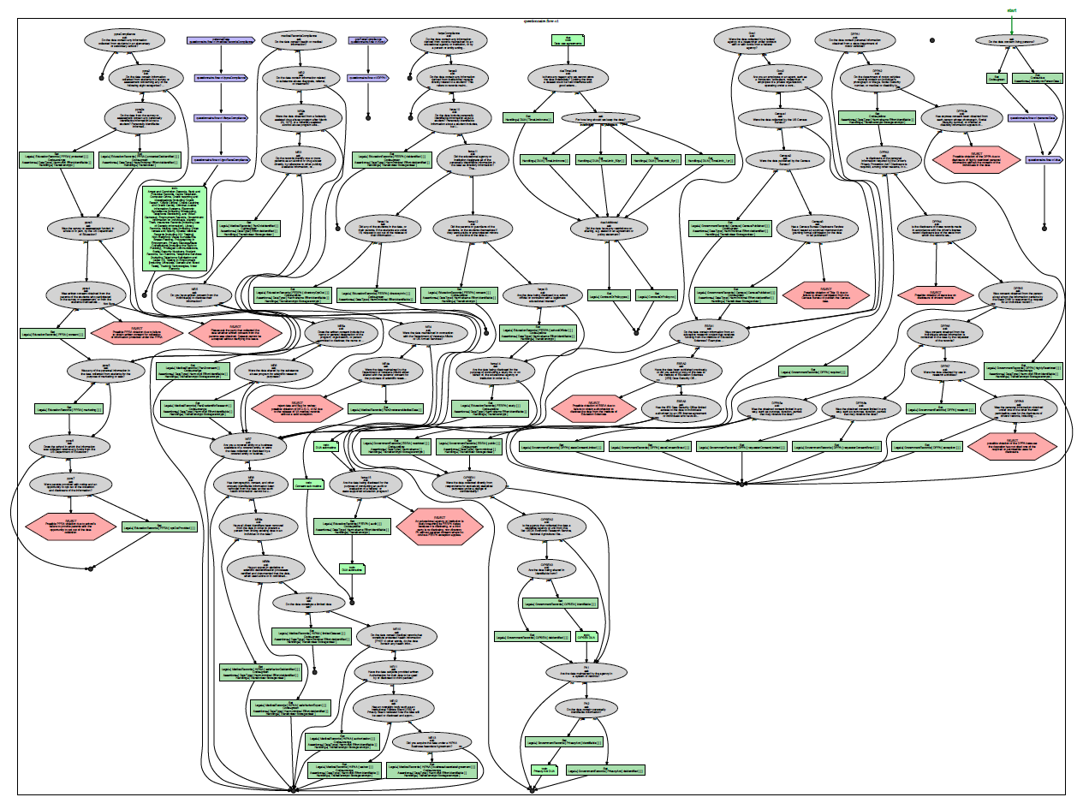
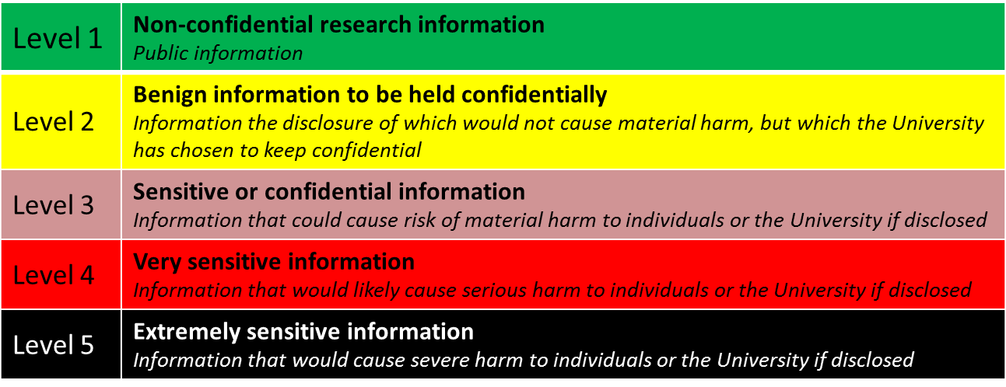




Privacy Definitions
DataTags: Legal Research & Development
Alexandra Wood (Fellow) & Olga Slobodyanyuk (Law Student Intern)
Berkman Center for Internet & Society
Data Use Agreements
University Data Classification & IRB Policies
Privacy Statutes & Regulations
Data Deposit
Direct Access
Objective
To analyze how different organizations interpret and apply statutory and regulatory requirements and common practices related to the sharing of research data in their data use agreements and policies.
Approach
Review of a sample of data sharing agreements and policies from over 100 data repositories, data enclaves, individual studies or data series, and organizations, such as academic institutions, government agencies, commercial entities, and nonprofit organizations.
Clustering of common terms into general categories and typologies of approaches within each category and formulation of corresponding DataTags questions and tags for each approach.
Common terms and approaches at the data ingestion and storage stage
Eligible data and depositors
Rights to an ownership of the data
Data contents (including identifiability and sensitivity of data contents)
Compliance with consent and human subjects protection rules
Repository rights and responsibilities
Acceptable end user access, use, and transfers of data (including: public access, restricted access, enclave access, embargoed access, and no access)
Data retention and withdrawal
Liability
Common terms and approaches at the data access and use stages
Data ownership
Access, use, sharing, and reuse restrictions (including tiered access models)
Data confidentiality and security procedures
De-identification requirements
Data retention requirements
Enforcement practices and procedures
Liability provisions
Attribution requirements
Sample DataTags Question
Under the agreement, with whom are users permitted to share the data? [Check all that apply.]
Any person named in the agreement (list of individuals provided as an attachment)
Collaborators working on the same research project
Any person named in the user’s application for the data
Any person upon obtaining written authorization from {the owner, the depositor, Dataverse}
Any person under the same terms and conditions as the data were provided to {Dataverse, the user}
Any person who has entered into an agreement with {the owner, the depositor, Dataverse}
Any person
The agreement prohibits users from sharing the data with anyone.
The agreement does not specify with whom users may share the data
Objective
To better understand how universities interpret and apply the range of human subjects protection regulations, data privacy laws and regulations, and data security best practices at the federal and state levels.
Approach
Review of IRB and data classification policies from 32 of the top research universities in the United States
Compilation of excerpts of the privacy-related language from the various policies in a 180+ page appendix
Analysis of the common features of the IRB and data aclassification policies, their relationship to each other, and their relationship to information privacy statutes and regulations
Observations
Common features of IRB policies
Definitions of terms such as privacy, confidentiality, anonymous, de-identified, sensitive information, personally identifiable information, and protected health information
Definitions typically reference regulations such as the Common Rule, HIPAA, FERPA, and state data protection standards
Explicit terms such as data minimization, linkage, security, and retention requirements
Variations among IRB policies
Identification of different typologies of approaches to privacy in IRB policies, ranging from policies that include no or minimal explicit requirements for privacy protection, to policies that cover comprehensive guidelines that extend beyond the minimum privacy protections required under the law
Common features of data classification policies
Data classification policies typically include 3-5 tiers of categories and provide a short list of examples of the types of information that fall within each category
Some university data classification policies are integrated with the university’s IRB policies, and, at other universities, these policies are distinct.
University data policies are broader in scope than IRB policies. They often address privacy and security issues beyond human subjects research protection, including GLBA, PCI-DSS, and other laws and standards related to the protection of information related to financial transactions, intellectual property and proprietary considerations, and laws related to export controlled data
Objective
To conduct legal research and draft memoranda analyzing the laws and regulations governing the sharing of research data.
To translate the legal requirements into a set of inference rules for determining, based on the properties of a dataset and its holder, which legal provisions apply and how the dataset should be handled as a result.
Approach
Overview of each law: legislative history, definitions of key terms (including judicial and administrative interpretations), key provisions related to the collection, use, and sharing of data, and any relevant exceptions to the general provisions
Legal analysis of each law and how it affects researchers and data repositories
Identification of the different categories of information that are covered under each law, the properties of the data and its holder that are relevant to determining whether it falls into one of the categories identified, and the data handling requirements for each category of information
Drafting of annotated questionnaire and formulation of corresponding tags and license terms
Statutes and Regulations Covered
The Common Rule
HIPAA Privacy Rule & Security Rule
Substance abuse confidentiality regulations
Family Educational Rights and Privacy Act (FERPA)
Protection of Pupil Rights Amendment (PPRA)
Education Sciences Reform Act
Privacy Act of 1974
Confidential Information Protection and Statistical Efficiency Act (CIPSEA)
Title 13, US Code
Driver’s Privacy Protection Act
Objective
To compare definitions of privacy and confidentiality (and related terms such as personally identifiable information and deidentification) across different areas of law and across different disciplines
To cluster and conduct a type analysis of the different categories of approaches
Approach
Survey of federal and state information privacy laws, regulations, and standards in the United States, including a spreadsheet of the definitions (and judicial and administrative interpretations) of the terms
Mapping of the definitions of personally identifiable information to the terms presented in Paul M. Schwartz & Daniel J. Solove, “The PII Problem: Privacy and a New Concept of Personally Identifiable Information,” 86 N.Y.U. L. Rev. 1814 (2011).
Tautological Approaches
Cable Communications Policy Act of 1984: “The term ‘personally identifiable information’ does not include any record of aggregate data which does not identify particular persons,” 47 U.S.C. § 551(a)(2)(A).
Confidential Information Protection and Statistical Efficiency Act
Education Sciences Reform Act of 2002
Non-public Approaches
Gramm-Leach-Bliley Act: “. . . personally identifiable financial information; and any list, description or other grouping of consumers, and publicly available information pertaining to them, that is derived using any personally identifiable financial information that is not publicly available information.” 17 C.F.R. 160.3(u)(1), (2).
The Common Rule
Federal Agency Data Mining Reporting Act of 2007
Video Voyeurism Prevention Act of 2004
Specific Types Approaches
HIPAA Privacy Rule: 18 identifiers enumerated under the definition of de-identified information, 45 C.F.R. § 164.514(b)(2)(i).
Family Educational Rights and Privacy Act of 1974
Privacy Act of 1974
Driver’s Privacy Protection Act of 1994
Data Tags
Icons representing restrictions
Dataset
Interview
Assess applicable:
Laws (HIPAA, FERPA, etc)
Contractual restrictions
Institutional policies
Custom Agreement
Access Control
DUAs, Legal Policies, Laws
Legal code

