Slide 1

Differential Privacy:
An Introduction
Salil Vadhan
Center for Research on Computation & Society
School of Engineering & Applied Sciences
Harvard University
Privacy Tools for Sharing Research Data
Summer 2015 Orientation

Slide 2
Data Privacy: The Problem
Given a dataset with sensitive information, such as:
Census data
Health records
Social network activity
Telecommunications data
How can we:
enable “desirable uses” of the data
while protecting the “privacy” of the data subjects?
Academic research
Informing policy
Identifying subjects for drug trial
Searching for terrorists
Market analysis
…
????

Slide 3
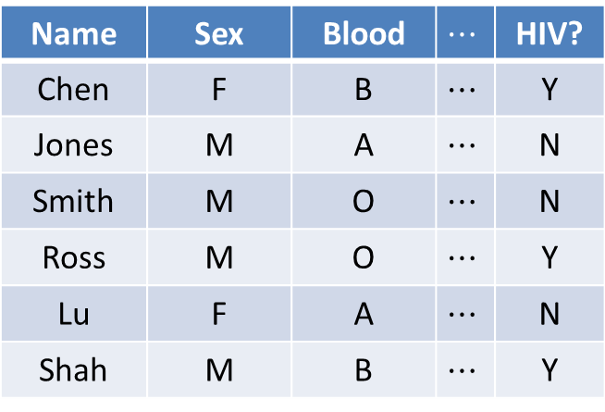
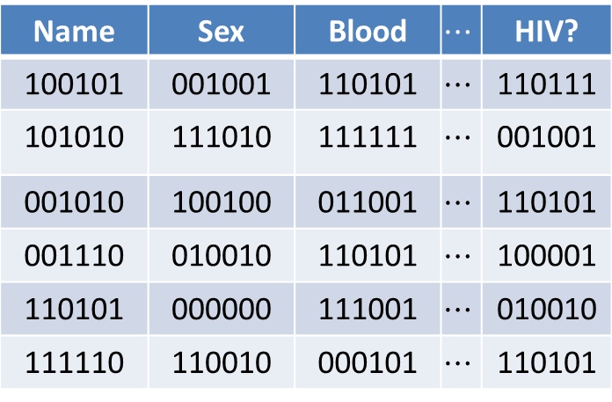
Approach 1: Encrypt the Data
Name | Sex | Blood | $$⋯$$ | HIV?
Chen | F | B | $$⋯$$ | Y
Jones | M | A | $$⋯$$ | N
Smith | M | O | $$⋯$$ | N
Ross | M | O | $$⋯$$ | Y
Lu | F | A | $$⋯$$ | N
Shah | M | B | $$⋯$$ | Y
Name | Sex | Blood | $$⋯$$ | HIV?
100101 | 001001 | 110101 | $$⋯$$ | 110111
101010 | 111010 | 111111 | $$⋯$$ | 001001
001010 | 100100 | 011001 | $$⋯$$ | 110101
001110 | 010010 | 110101 | $$⋯$$ | 100001
110101 | 000000 | 111001 | $$⋯$$ | 010010
111110 | 110010 | 000101 | $$⋯$$ | 110101
Problems?

Slide 4
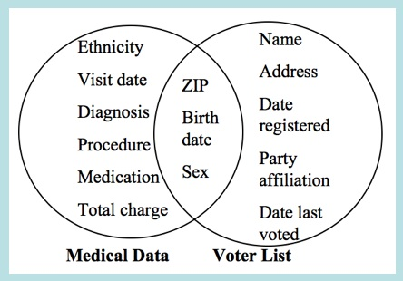
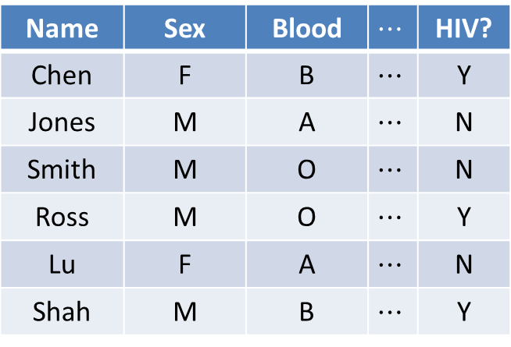
Approach 2: Anonymize the Data
Name | Sex | Blood | $$⋯$$ | HIV?
Chen | F | B | $$⋯$$ | Y
Jones | M | A | $$⋯$$ | N
Smith | M | O | $$⋯$$ | N
Ross | M | O | $$⋯$$ | Y
Lu | F | A | $$⋯$$ | N
Shah | M | B | $$⋯$$ | Y
[Sweeney `97]
“re-identification” often easy
Problems?

Slide 5
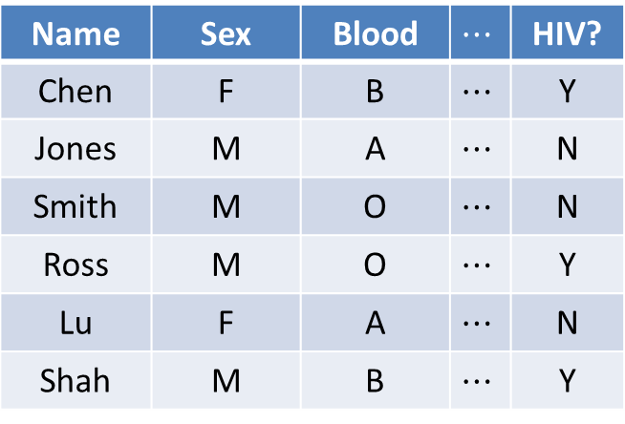

Approach 3: Mediate Access
C
Name | Sex | Blood | $$⋯$$ | HIV?
Chen | F | B | $$⋯$$ | Y
Jones | M | A | $$⋯$$ | N
Smith | M | O | $$⋯$$ | N
Ross | M | O | $$⋯$$ | Y
Lu | F | A | $$⋯$$ | N
Shah | M | B | $$⋯$$ | Y
q₁
a₁
C
q₂
a₂
q₃
a₃
trusted
“curator”
data analysts
Problems?

Slide 6
Privacy Models from CS
Model | Utility | Privacy | Who Holds Data?
Differential Privacy | statistical analysis of dataset | individual-specific info | trusted curator
Secure Function Evaluation | any query desired | everything other than result of query | original users (or semi-trusted delegates)
Fully Homomorphic (or Functional) Encryption | any query desired | everything (except possibly result of query) | untrusted server
For other two topics, see Shafi Goldwasser’s talk
at White House-MIT Big Data Privacy Workshop 3/3/14

Slide 7
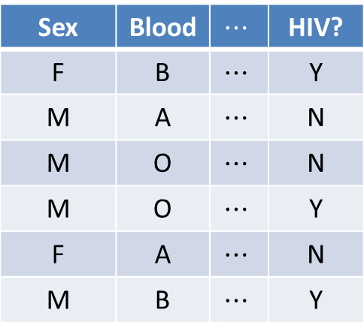
Differential privacy
[Dinur-Nissim ’03+Dwork, Dwork-Nissim ’04, Blum-Dwork-McSherry-Nissim ’05, Dwork-McSherry-Nissim-Smith ’06]
C
Sex | Blood | $$⋯$$ | HIV?
F | B | $$⋯$$ | Y
M | A | $$⋯$$ | N
M | O | $$⋯$$ | N
M | O | $$⋯$$ | Y
F | A | $$⋯$$ | N
M | B | $$⋯$$ | Y
q₁
a₁
C
q₂
a₂
q₃
a₃
curator
data analysts
Requirement: effect of each individual should be “hidden”

Slide 8
Differential privacy
[Dinur-Nissim ’03+Dwork, Dwork-Nissim ’04, Blum-Dwork-McSherry-Nissim ’05, Dwork-McSherry-Nissim-Smith ’06]
C
Sex | Blood | $$⋯$$ | HIV?
F | B | $$⋯$$ | Y
M | A | $$⋯$$ | N
M | O | $$⋯$$ | N
M | O | $$⋯$$ | Y
F | A | $$⋯$$ | N
M | B | $$⋯$$ | Y
q₁
a₁
C
q₂
a₂
q₃
a₃
curator
adversary

Slide 9
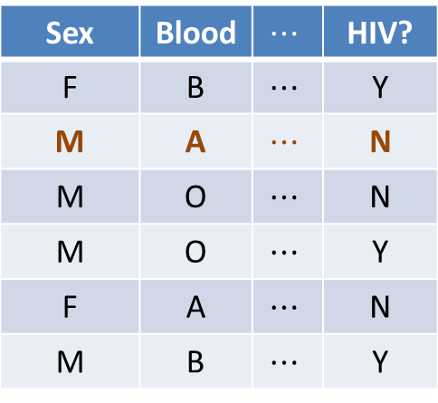
Differential privacy
[Dinur-Nissim ’03+Dwork, Dwork-Nissim ’04, Blum-Dwork-McSherry-Nissim ’05, Dwork-McSherry-Nissim-Smith ’06]
C
Sex | Blood | $$⋯$$ | HIV?
F | B | $$⋯$$ | Y
M | A | $$⋯$$ | N
M | O | $$⋯$$ | N
M | O | $$⋯$$ | Y
F | A | $$⋯$$ | N
M | B | $$⋯$$ | Y
q₁
a₁
C
q₂
a₂
q₃
a₃
curator
adversary
Requirement: an adversary shouldn’t be able to
tell if any one person’s data were changed arbitrarily

Slide 10
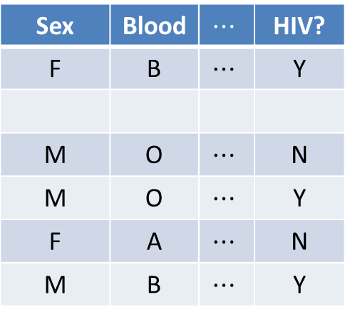
Differential privacy
[Dinur-Nissim ’03+Dwork, Dwork-Nissim ’04, Blum-Dwork-McSherry-Nissim ’05, Dwork-McSherry-Nissim-Smith ’06]
C
Sex | Blood | $$⋯$$ | HIV?
F | B | $$⋯$$ | Y
M | O | $$⋯$$ | N
M | O | $$⋯$$ | Y
F | A | $$⋯$$ | N
M | B | $$⋯$$ | Y
q₁
a₁
C
q₂
a₂
q₃
a₃
curator
adversary
Requirement: an adversary shouldn’t be able to
tell if any one person’s data were changed arbitrarily

Slide 11
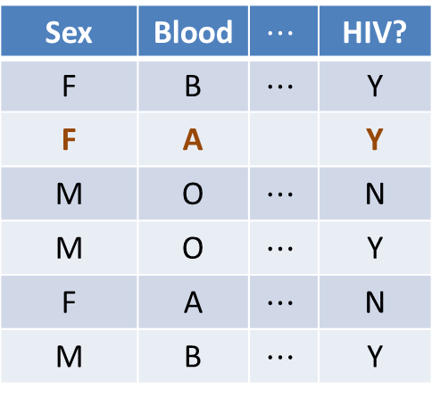
Differential privacy
[Dinur-Nissim ’03+Dwork, Dwork-Nissim ’04, Blum-Dwork-McSherry-Nissim ’05, Dwork-McSherry-Nissim-Smith ’06]
C
Sex | Blood | $$⋯$$ | HIV?
F | B | $$⋯$$ | Y
F | A |  | Y
M | O | $$⋯$$ | N
M | O | $$⋯$$ | Y
F | A | $$⋯$$ | N
M | B | $$⋯$$ | Y
q₁
a₁
C
q₂
a₂
q₃
a₃
curator
adversary
Requirement: an adversary shouldn’t be able to
tell if any one person’s data were changed arbitrarily

Slide 12

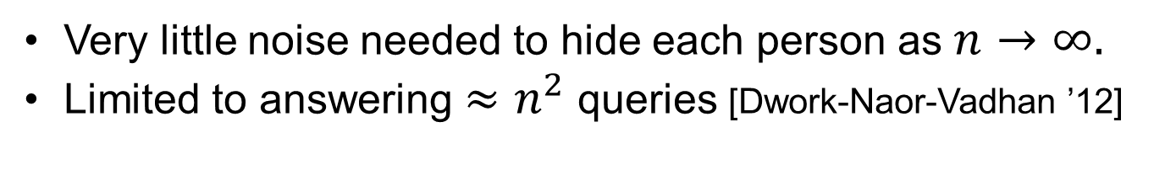
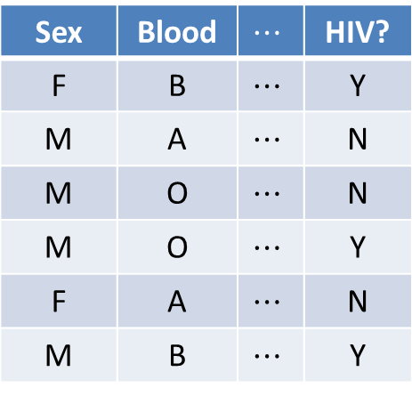
Simple approach: random noise
Sex | Blood | $$⋯$$ | HIV?
F | B | $$⋯$$ | Y
M | A | $$⋯$$ | N
M | O | $$⋯$$ | N
M | O | $$⋯$$ | Y
F | A | $$⋯$$ | N
M | B | $$⋯$$ | Y
C
“What fraction of people are type B and HIV positive?”
C
$$n$$
Answer + Random Noise
Very little noise needed to hide each person as $n→∞.$
Limited to answering $≈n^{2}$queries [Dwork-Naor-Vadhan ’12]

Slide 13
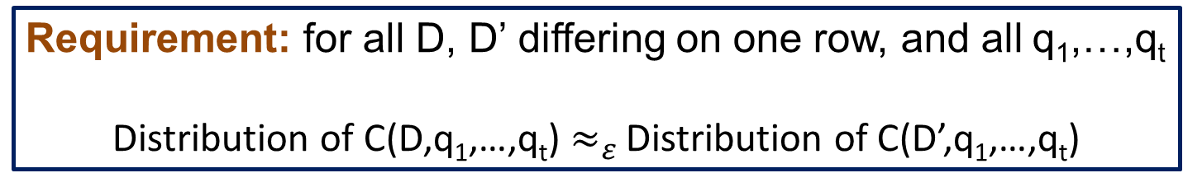
Differential privacy
[Dinur-Nissim ’03+Dwork, Dwork-Nissim ’04, Blum-Dwork-McSherry-Nissim ’05, Dwork-McSherry-Nissim-Smith ’06]
C
Sex | Blood | $$⋯$$ | HIV?
F | B | $$⋯$$ | Y
F | A |  | Y
M | O | $$⋯$$ | N
M | O | $$⋯$$ | Y
F | A | $$⋯$$ | N
M | B | $$⋯$$ | Y
q₁
a₁
C
q₂
a₂
q₃
a₃
randomized
curator
adversary
Requirement: for all D, D’ differing on one row, and all q₁,…,q_{t}
Distribution of C(D,q₁,…,q_{t}) $≈_{ε }$Distribution of C(D’,q₁,…,q_{t})

Slide 14
Some Differentially Private Algorithms
histograms [DMNS06]
contingency tables [BCDKMT07, GHRU11, TUV12, DNT14],
machine learning [BDMN05,KLNRS08],
regression & statistical estimation [CMS11,S11,KST11,ST12,JT13]
clustering [BDMN05,NRS07]
social network analysis [HLMJ09,GRU11,KRSY11,KNRS13,BBDS13]
approximation algorithms [GLMRT10]
singular value decomposition [HR12, HR13, KT13, DTTZ14]
streaming algorithms [DNRY10,DNPR10,MMNW11]
mechanism design [MT07,NST10,X11,NOS12,CCKMV12,HK12,KPRU12]
…
See Simons Institute Workshop on Big Data & Differential Privacy 12/13

Slide 15
Differential Privacy: Interpretations
Whatever an adversary learns about me, it could have learned from everyone else’s data.
Mechanism cannot leak “individual-specific” information.
Above interpretations hold regardless of adversary’s auxiliary information.
Composes gracefully (k repetitions ) kε differentially private)
But
No protection for information that is not localized to a few rows.
No guarantee that subjects won’t be “harmed” by results of analysis.
Distribution of C(D,q₁,…,q_{t}) $≈_{ε}$Distribution of C(D’,q₁,…,q_{t})

Slide 16
Simple approach: random noise
Sex | Blood | $$⋯$$ | HIV?
F | B | $$⋯$$ | Y
M | A | $$⋯$$ | N
M | O | $$⋯$$ | N
M | O | $$⋯$$ | Y
F | A | $$⋯$$ | N
M | B | $$⋯$$ | Y
C
“What fraction of people are type B and HIV positive?”
C
$$n$$
Answer + Random Noise
Very little noise needed to hide each person as $n→∞.$
Limited to answering $≈n^{2}$queries [Dwork-Naor-Vadhan ’12]

Slide 17


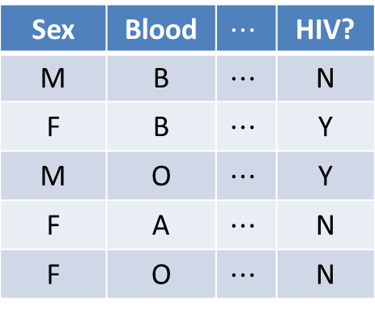
Amazing possibility: synthetic data
[Blum-Ligett-Roth ’08]
Sex | Blood | $$⋯$$ | HIV?
F | B | $$⋯$$ | Y
M | A | $$⋯$$ | N
M | O | $$⋯$$ | N
M | O | $$⋯$$ | Y
F | A | $$⋯$$ | N
M | B | $$⋯$$ | Y
Sex | Blood | $$⋯$$ | HIV?
M | B | $$⋯$$ | N
F | B | $$⋯$$ | Y
M | O | $$⋯$$ | Y
F | A | $$⋯$$ | N
F | O | $$⋯$$ | N
C
C
$$n$$
“fake” people
$$d≪n$$
  Utility: preserves fraction of people with every set of attributes!
Challenge: make this computationally feasible for high-dimensional datasets

Slide 18
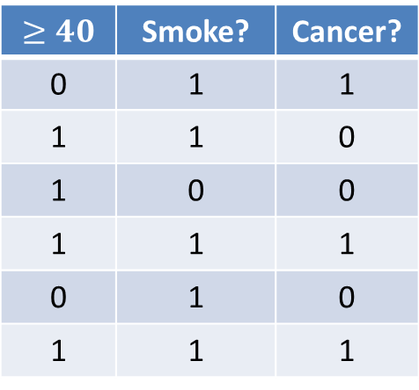
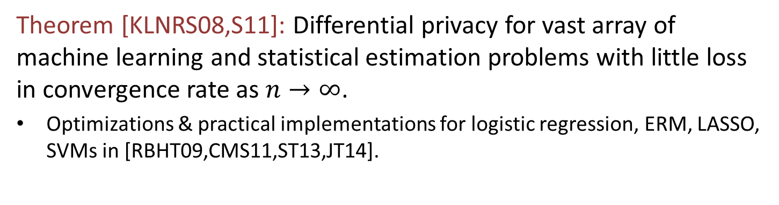
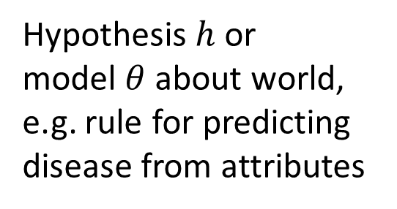


Amazing Possibility II:
Statistical Inference & Machine Learning
$$≥40$$ | Smoke? | Cancer?
0 | 1 | 1
1 | 1 | 0
1 | 0 | 0
1 | 1 | 1
0 | 1 | 0
1 | 1 | 1
Hypothesis$h$or
model $θ$about world,
e.g. rule for predicting
disease from attributes
C
$$n$$
$$d$$
Theorem [KLNRS08,S11]: Differential privacy for vast array of machine learning and statistical estimation problems with little loss in convergence rate as $n→∞$.
Optimizations & practical implementations for logistic regression, ERM, LASSO, SVMs in [RBHT09,CMS11,ST13,JT14].

Slide 19
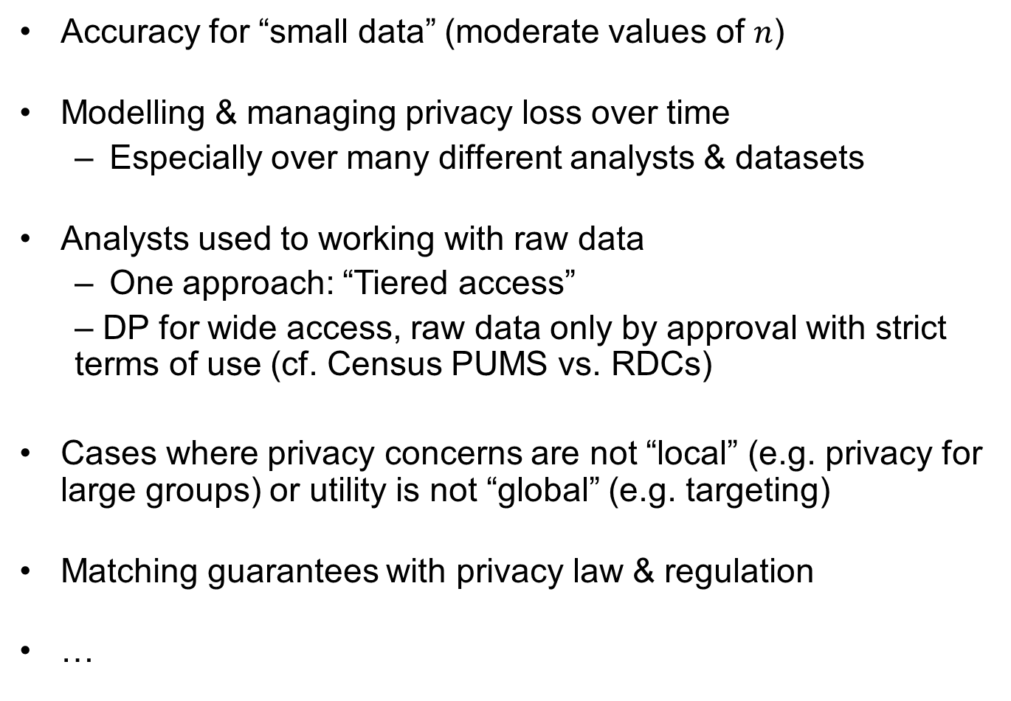
Challenges for DP in Practice
Accuracy for “small data” (moderate values of $n$)
Modelling & managing privacy loss over time
  Especially over many different analysts & datasets
Analysts used to working with raw data
  One approach: “Tiered access”
  – DP for wide access, raw data only by approval with strict terms of use (cf. Census PUMS vs. RDCs)
Cases where privacy concerns are not “local” (e.g. privacy for large groups) or utility is not “global” (e.g. targeting)
Matching guarantees with privacy law & regulation
…

Slide 20
Some Efforts to Bring DP to Practice
CMU-Cornell-PennState “Integrating Statistical and Computational Approaches to Privacy”
  See http://onthemap.ces.census.gov/
UCSD “Integrating Data for Analysis, Anonymization, and Sharing” (iDash)
UT Austin “Airavat: Security & Privacy for MapReduce”
UPenn “Putting Differential Privacy to Work”
Stanford-Berkeley-Microsoft “Towards Practicing Privacy”
Duke-NISSS “Triangle Census Research Network”
Harvard “Privacy Tools for Sharing Research Data”
…

Slide 21
Goals for our DP Tools
General-purpose: applicable to most datasets uploaded to Dataverse.
Automated: no differential privacy expert optimizing algorithms for a particular dataset or application
Tiered access: DP interface for wide access to rough statistical information, helping users decide whether to apply for access to raw data (cf. Census PUMS vs RDCs)

Slide 22
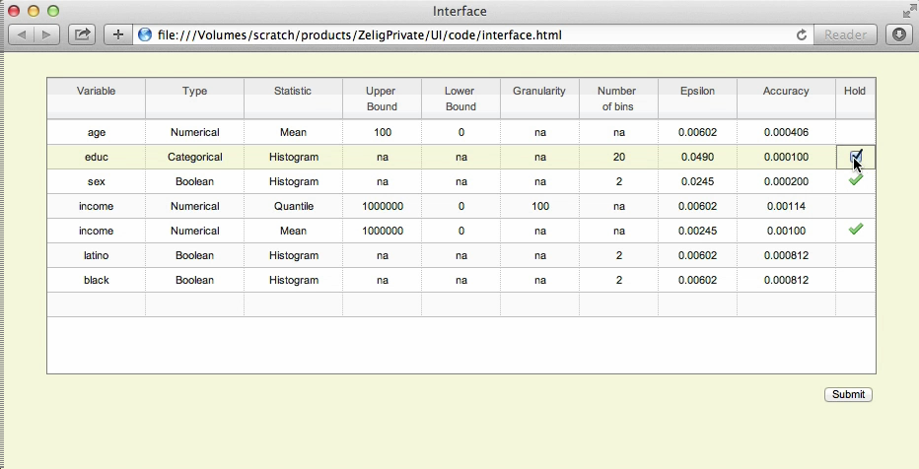
Demo of our DP Tools

Slide 23
Where we’re headed
Current Tool
Means, quantiles, CDFs, histograms
Computed at time of dataset deposit
Depositor decides how to allocate “privacy budget”
This Summer
Interactive queries by data analyst
Visualization of error introduced by DP in TwoRavens
Utility testing for social science
Least-squares regression
Contingency tables
Integration with Dataverse
Attacks on aggregate data

Slide 24
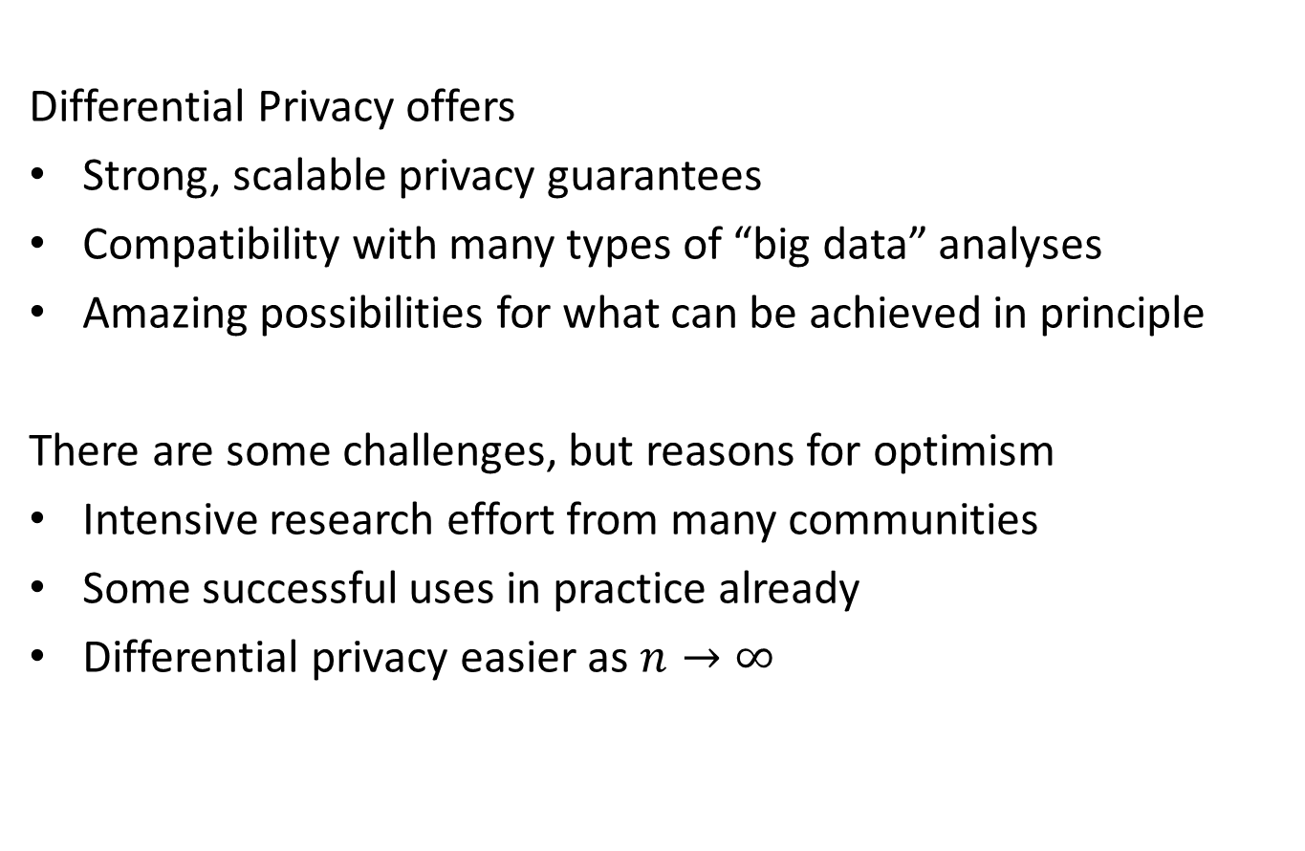
Differential Privacy: Summary
Differential Privacy offers
Strong, scalable privacy guarantees
Compatibility with many types of “big data” analyses
Amazing possibilities for what can be achieved in principle
There are some challenges, but reasons for optimism
Intensive research effort from many communities
Some successful uses in practice already
Differential privacy easier as $n→∞$

