Slide 1

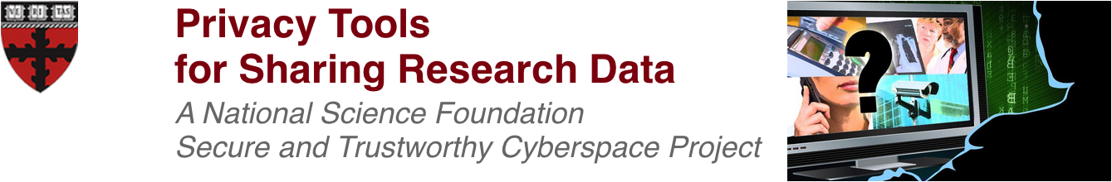
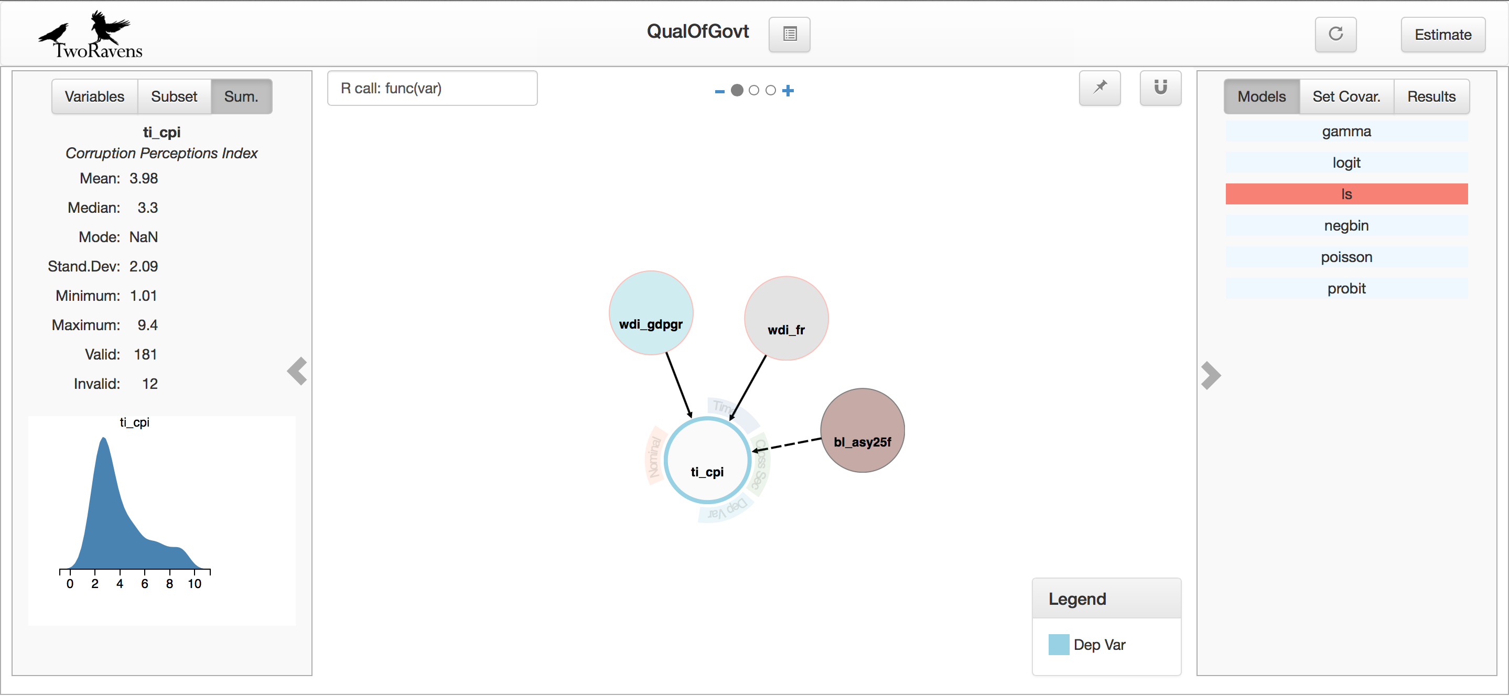
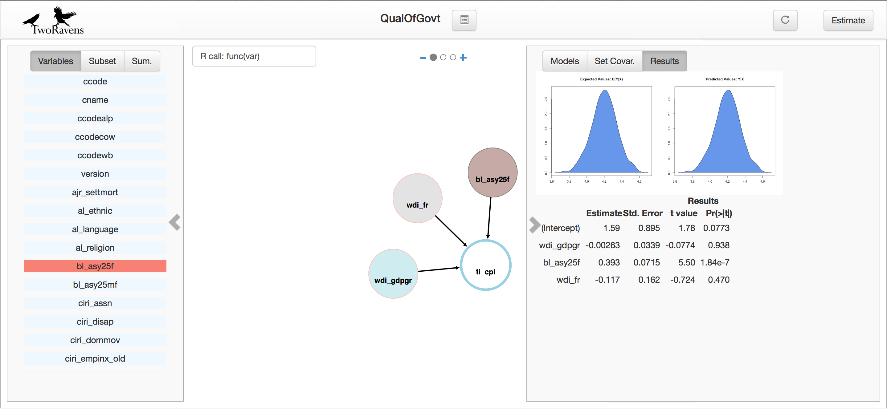




Vito D’Orazio and James Honaker
Institute for Quantitative Social Science
Harvard University
Abstract
TwoRavens User Interface
TwoRavens is a graphical user interface for quantitative analysis that allows users at all levels of statistical expertise to explore their data, describe their substantive understanding of the data, and appropriately construct and interpret statistical models. The interface is a browser-based, thin client, with the data remaining in an online repository, and the statistical modeling occurring on a remote server. Because of this, TwoRavens is easily adaptable to the role of a privacy preserving curator. In the private implementation, we integrate with datasets from the Dataverse repository that contain sensitive information, and use privacy preserving algorithms, some of which are built into the Zelig package for the R statistical language, to calculate descriptive statistics. Our gesture-based user interface allows for interactive statistical modeling and a graphical display of all statistical results.
Private Zelig Models
Private
Statistics
Interactive
Modeling
Space
TwoRavens User Interface
System Architecture
The TwoRavens architecture has been built to ensure easy adaptability to the role of trusted, privacy preserving curator. At the user layer, the interface never touches the data, only the metadata, which for sensitive datasets will contain only private statistics. For interactive requests, the data are housed in a secure Dataverse repository and accessed at the server layer. The interface simply packages the request and displays the private results.
Private Model
Estimates
Variable
List

