Slide 1

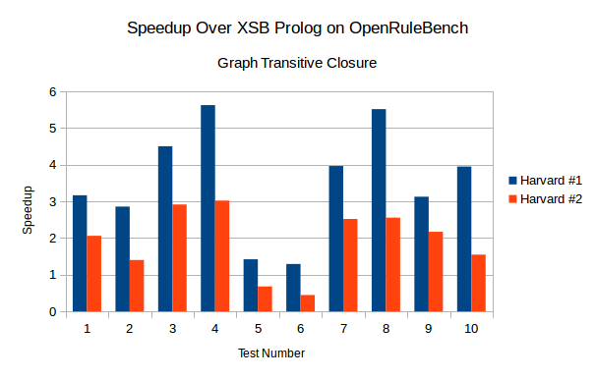
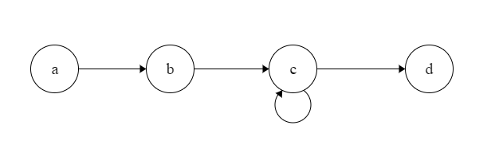




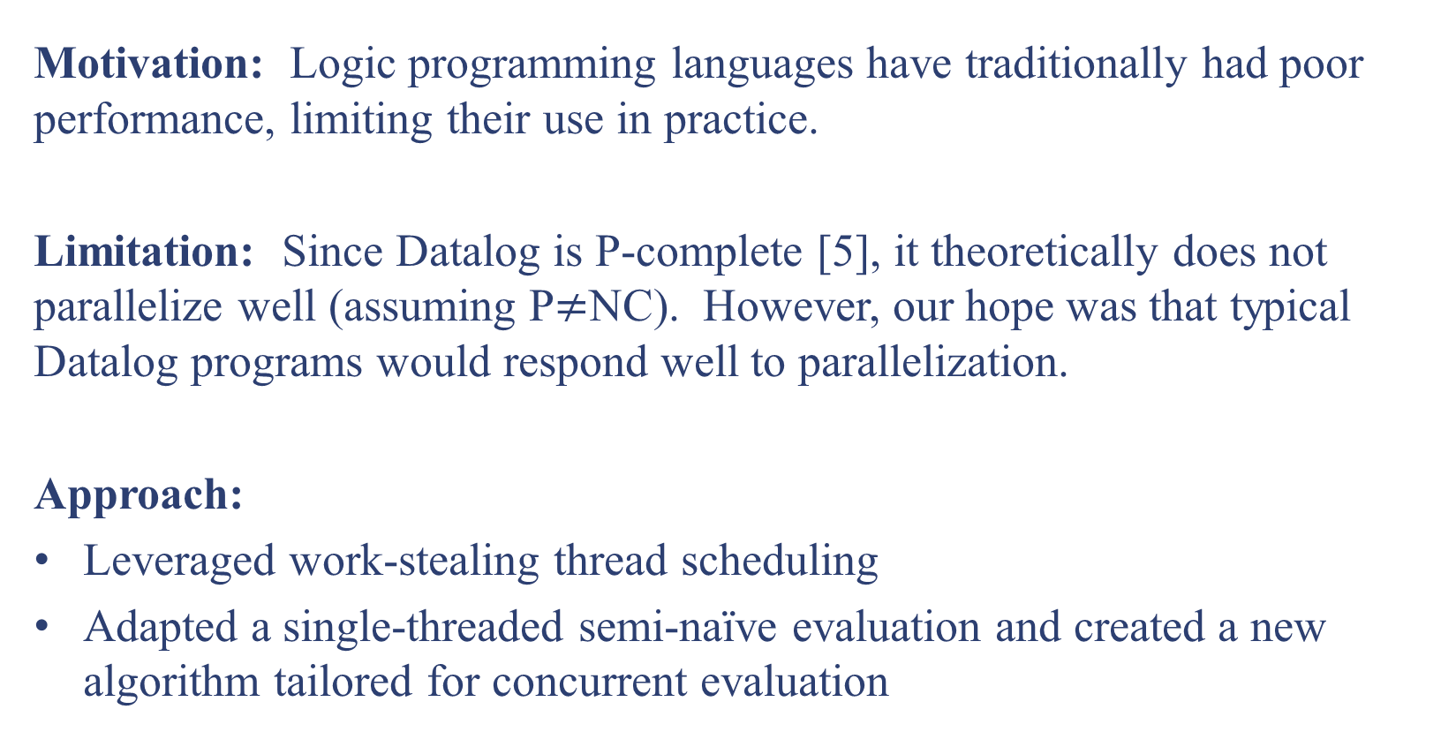
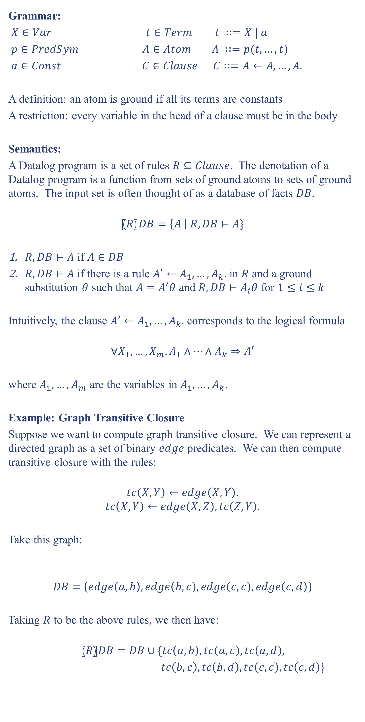
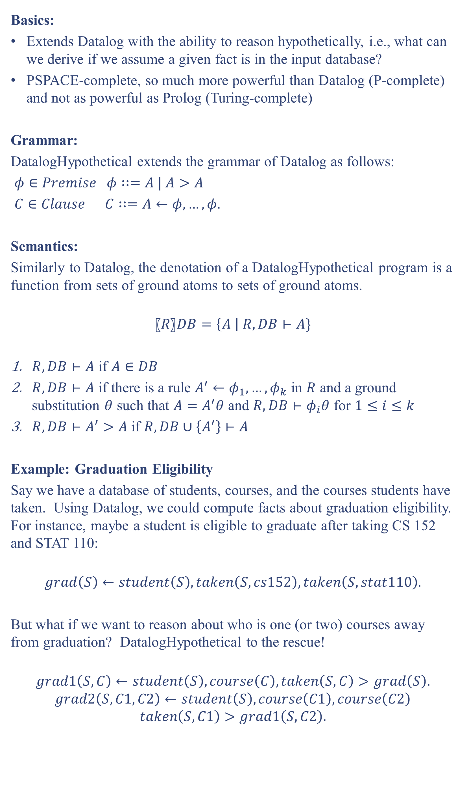
Efficient and Extensible Datalog
Aaron Bembenek¹, Stephen Chong¹, and Marco Gaboardi²
¹ Harvard University ² University of Dundee
with additional support from the Sloan Foundation and Google, Inc.
Motivation and Initial Objectives
Grammar:
$X∈Var t∈Term t ∷=X | a$
$p∈PredSym$ $A∈Atom A ∷=p(t,…,t)$
$a∈Const$ $C∈Clause C∷=A←A,…, A.$
A definition: an atom is ground if all its terms are constants
A restriction: every variable in the head of a clause must be in the body
Semantics:
A Datalog program is a set of rules $R⊆Clause$. The denotation of a Datalog program is a function from sets of ground atoms to sets of ground atoms. The input set is often thought of as a database of facts $DB$.
$$〖R〗DB=\left\{A \right| R,DB⊢A\}$$
$R,DB⊢A$ if $A∈DB$
$R,DB⊢A$ if there is a rule $A^{′}←A_{1},…,A_{k}.$ in $R$ and a ground substitution $θ$ such that $A=A^{′}θ$ and $R,DB⊢A_{i}θ$ for $1≤i≤k$
Intuitively, the clause $A^{′}←A_{1},…,A_{k}.$ corresponds to the logical formula
$$∀X_{1},…,X_{m}.A_{1}∧⋯∧A_{k}⇒A′$$
where $A_{1},…,A_{m}$ are the variables in $A_{1},…,A_{k}$.
Example: Graph Transitive Closure
Suppose we want to compute graph transitive closure. We can represent a directed graph as a set of binary $edge$ predicates. We can then compute transitive closure with the rules:
$$tc\left(X,Y\right)←edge\left(X,Y\right).$$
$$tc\left(X,Y\right)←edge\left(X,Z\right), tc\left(Z,Y\right).$$
Take this graph:
$$DB=\left\{edge\left(a,b\right),edge\left(b,c\right),edge\left(c,c\right),edge\left(c,d\right)\right\}$$
Taking $R$ to be the above rules, we then have:
$$〖R〗DB=DB∪\{tc\left(a,b\right),tc\left(a,c\right),tc\left(a,d\right),$$
$tc\left(b,c\right),tc\left(b,d\right), tc\left(c,c\right),tc\left(c,d\right)\}$
Results:
1.2-5X speedup over XSB Prolog (a leading implementation) when using 32 cores on the transitive closure test suite from the OpenRuleBench benchmarks [7]
Next Steps:
Leverage profiling tools to find opportunities for further optimizations
Test performance on other Datalog programs (besides transitive closure)
Potential Applications in Privacy Tools
We were primarily motivated by the lack of a good, open-source, Java-based implementation of the logic programming language Datalog. We wanted to have such an implementation as the backend for other projects within Privacy Tools.
Accordingly, our primary goal for this project was to create a Java-based Datalog engine. Ideally, the engine would also:
Take advantage of multiple cores during query evaluation
Be easily extensible with new evaluation strategies or even new language features
Provide a clean (and easily extensible) Java interface so that it could efficiently be integrated within other JVM-based applications
As secondary goals, we also hoped to:
Create pedagogical material to accompany our implementation, such as a tutorial
Implement new language features, such as types or limited function symbols
Modeling Privacy Legislation for DataTags:
DataTags broadly state permitted and disallowed actions on datasets, always giving “safe” answers, even when a particular action might be allowed on a particular dataset
We hope to encode relevant portions of privacy legislation in a logic program to allow a finer-grained analysis
Having our own implementation of Datalog will allow us to create new language features as necessary
In particular, our DatalogHypothetical implementation might be helpful, as hypotheticals were found to be useful in formalizing the British Nationality Act [4]
Declarative Encoding of DataTags Questionnaires:
Questionnaires currently encoded in a procedural manner
Datalog has the potential to encode questionnaires declaratively, which would allow for easier extensibility and maintenance
Open questions include how to extend Datalog with dynamic user interaction, and how to determine the best order to ask questions
Having a home-built Datalog implementation will allow us to more easily explore these issues
Current Status
DatalogHypothetical [2,8]
We have built an engine that seamlessly supports over half-a-dozen query evaluation strategies, including:
Bottom-up techniques that derive all facts
Top-down techniques that derive only the facts necessary to answer a particular query
Program rewriting techniques that transform programs in response to a query so that bottom-up evaluation is as efficient as top-down evaluation
We have experimented with different concurrent evaluation techniques to improve scalability, both by adapting single-threaded algorithms and creating new algorithms more suitable for concurrent evaluation.
We have also implemented a language extension that allows for hypothetical reasoning known as DatalogHypothetical.
Finally, we have created a simple graphical user interface, which is suitable for use in an undergraduate programming language course.
Developer can load, edit and save Datalog source code
Datalog programs can be dynamically loaded and queried with a built-in interpreter to give the developer real-time feedback
Basics:
Extends Datalog with the ability to reason hypothetically, i.e., what can we derive if we assume a given fact is in the input database?
PSPACE-complete, so much more powerful than Datalog (P-complete) and not as powerful as Prolog (Turing-complete)
Grammar:
DatalogHypothetical extends the grammar of Datalog as follows:
$φ∈Premise φ∷=A | A>A$
$C∈Clause C∷=A←φ,…, φ.$
Semantics:
Similarly to Datalog, the denotation of a DatalogHypothetical program is a function from sets of ground atoms to sets of ground atoms.
$$〖R〗DB=\left\{A \right| R,DB⊢A\}$$
$R,DB⊢A$ if $A∈DB$
$R,DB⊢A$ if there is a rule $A^{′}←φ_{1},…,φ_{k}$ in $R$ and a ground substitution $θ$ such that $A=A^{′}θ$ and $R,DB⊢φ_{i}θ$ for $1≤i≤k$
$R,DB⊢A^{′}>A$ if $R,DB∪\left\{A^{′}\right\}⊢A$
Example: Graduation Eligibility
Say we have a database of students, courses, and the courses students have taken. Using Datalog, we could compute facts about graduation eligibility. For instance, maybe a student is eligible to graduate after taking CS 152 and STAT 110:
$$grad\left(S\right)←student\left(S\right),taken\left(S,cs152\right),taken\left(S,stat110\right).$$
But what if we want to reason about who is one (or two) courses away from graduation? DatalogHypothetical to the rescue!
$$grad1\left(S,C\right)←student\left(S\right),course\left(C\right),taken\left(S,C\right)>grad\left(S\right).$$
$$grad2\left(S,C1,C2\right)←student\left(S\right),course\left(C1\right),course\left(C2\right)$$
$$taken\left(S,C1\right)>grad1\left(S,C2\right).$$
References
Serge Abiteboul, Richard Hull, and Victor Vianu. 1995. Foundations of Databases. Addison-Wesley, Reading, MA.
Anthony J. Bonner. 1990. Hypothetical datalog: complexity and expressibility. Theor. Comput. Sci. 76, 1 (October 1990), 3-51. DOI=10.1016/0304-3975(90)90011-6 http://dx.doi.org/10.1016/0304-3975(90)90011-6
S. Ceri, G. Gottlob, and L. Tanca. 1989. What You Always Wanted to Know About Datalog (And Never Dared to Ask). IEEE Trans. on Knowl. and Data Eng. 1, 1 (March 1989), 146-166. DOI=10.1109/69.43410 http://dx.doi.org/10.1109/69.43410
D.M. Gabbay, U. Reyle, N-Prolog: An extension of Prolog with hypothetical implications. I., The Journal of Logic Programming, Volume 1, Issue 4, 1984, Pages 319-355, ISSN 0743-1066, http://dx.doi.org/10.1016/0743-1066(84)90029-3.
Evgeny Dantsin, Thomas Eiter, Georg Gottlob, and Andrei Voronkov. 2001. Complexity and expressive power of logic programming. ACM Comput. Surv. 33, 3 (September 2001), 374-425. DOI=10.1145/502807.502810 http://doi.acm.org/10.1145/502807.502810
Todd J. Green, Shan Shan Huang, Boon Thau Loo, and Wenchao Zhou. 2013. Datalog and Recursive Query Processing. Found. Trends databases 5, 2 (November 2013), 105-195. DOI=10.1561/1900000017 http://dx.doi.org/10.1561/1900000017
Senlin Liang, Paul Fodor, Hui Wan, and Michael Kifer. 2009. OpenRuleBench: an analysis of the performance of rule engines. In Proceedings of the 18th international conference on World wide web (WWW '09). ACM, New York, NY, USA, 601-610. DOI=http://dx.doi.org/10.1145/1526709.1526790
Henning Christiansen and Troels Andreasen. 1996. A Practical Approach to Hypothetical Database Queries. In International Seminar on Logic Databases and the Meaning of Change, Transactions and Change in Logic Databases (ILPS '97), Burkhard Freitag, Hendrik Decker, Michael Kifer, and Andrei Voronkov (Eds.). Springer-Verlag, London, UK, UK, 340-355.
Datalog Overview [1,3,6]
Parallelizing Datalog
Basics:
Logic programming language born from the intersection of database theory and logic
Truly declarative (unlike Prolog), which allows programmers to focus on what they want to compute, not how they have to compute it
Supports recursively defined rules (unlike query languages based in relational algebra)
P-complete, so every Datalog computation is guaranteed to terminate in time polynomial in the size of the input database
Motivation: Logic programming languages have traditionally had poor performance, limiting their use in practice.
Limitation: Since Datalog is P-complete [5], it theoretically does not parallelize well (assuming P$≠$NC). However, our hope was that typical Datalog programs would respond well to parallelization.
Approach:
Leveraged work-stealing thread scheduling
Adapted a single-threaded semi-naïve evaluation and created a new algorithm tailored for concurrent evaluation

