Slide 1
Privacy TOOLS FOR SHARING RESEARCH DATA
A multidisciplinary project at Harvard University
Presented by: Salil Vadhan
Supported by an NSF Secure & Trustworthy Cyberspace (SaTC) “frontier” grant and a gift from Google, Inc.
Notes:
I’m going to give a brief overview of our multidisciplinary project on Privacy for Social Science Research, which we’ve been developing at Harvard over the past couple of years, with the help of a small amount of seed funding from Google, and which we are very excited about bringing to full scale.
I am Salil Vadhan, the lead PI on the project. My background is in theoretical computer science and cryptography, and much of my work in the past few years has been on data privacy.

Slide 2
Goal for today
Share a sense of what we’d like to accomplish, both long-term and in Year 1.
Next steps for you:
Think about where you might like to connect.
Respond to forthcoming email surveys.
Join more focused research meetings on specific topics.

Slide 3

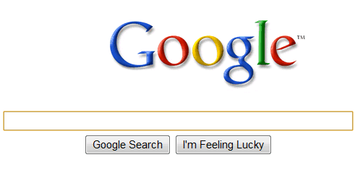


Computational Social Science
The potential: massive new sources of data and ease of sharing will revolutionize social science.
The problem: protecting the privacy of individual subjects
utility
traditional approaches
(e.g. “stripping PII”)
privacy
open data
privacy
e.g. NYT 5/21/12 “Troves of Personal Data, Forbidden to Researchers”
Notes:
The context for our project is the exciting transformation that is happening in social science, due to the immense variety and volume of new sources of data on human behavior. Instead of being limited to surveys of a few thousand people, researchers can carry out studies on the scale of hundreds of thousands by using data from new sources such as cell phone GPS readings, web searches, political blog posts, and social network activity. Moreover, the internet and data repositories such as the Dataverse Network (which I’ll talk about later) have made it much easier to share such data with other researchers enable replication and new analyses.
However, a major obstacle for realizing the full potential of this vision is Privacy. Most of these datasets contain sensitive personal information about individuals, and currently social scientists do not have the tools to ensure that the privacy of those individuals is protected when the data is analyzed or shared. The result is that researchers are refusing to share their data, clashing with the growing movement towards open sharing of data being pushed by the research community and funding agencies.
What do about this? The traditional approach is to try and anonymize data by removing so-called “personally identifying information”. However, it is now well-known that this technique does not work, because moderate amounts of seemingly innocuous information can already uniquely isolate individuals, and this information can often be linked with other publicly available data to re-identify the individuals in supposedly anonymized datasets. This problem was demonstrated in work by my co-PI Latanya Sweeney a number of years ago linking anonymized medical claims data with public voter registration rolls to uniquely identify the record of Massachusetts governer William Weld, and has become much more acute with the vast amounts of data that is publicly available on the internet. Indeed, there have been many more examples of reidentifications since then.
Thus, this traditional approach presents us with a stark choice between privacy and data utility. If you remove only obviously identifying information, then the privacy is very weak – you’ve just made it slightly harder to identify individuals. If you aggressively de-identify, then the resulting dataset may have very little utliity left – you may have removed exactly the information you are interested in studying.

Slide 4
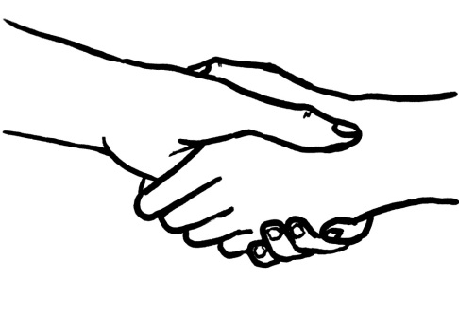
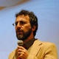
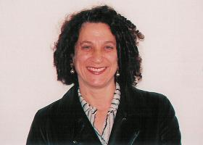

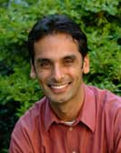
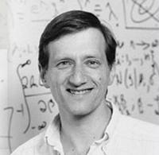






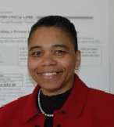





Our Goal
utility
Achieve:
privacy
&
open data
Altman
(MIT)
privacy
Via:
Dwork
(MSR)
social
science
Chong
Vadhan
King
Crosas
computer
science
statistics
Malone
Sweeney
Airoldi
Nissim
(BGU)
law &
policy
Notes:
The goal of our project is to help relieve these tensions. To enable both privacy and open sharing of data, and to work towards pushing this utility vs. privacy curve out as much as possible – so that one can simultaneously have a large amount of both.
We will achieve our goals through the combined effort of several disciplines:
From computer science, we will draw upon a recent and flourishing body of work that has illuminated our conception of data privacy through the introduction of strong protection models such as differential privacy, and has provided algorithms that achieve strong privacy guarantees while minimally distorting data (or the results of queries on data).
To understand whether these methods provide utility in practice, we need to understand the needs and constraints of our users. For us, these are the social scientists and statisticians who are collecting, sharing, and analyzing privacy-sensitive data.
Finally, the technological solutions coming from computer science and statistics need to be developed in tandem with appropriate legal and policy instruments that guide and support researchers as they handle privacy-sensitive data.
The project comes out of a collaboration between 4 institutes at harvard, that are each multidisciplinary, but with different emphases, and collectively range across the disciplines relevant to our project.
From these institutes, we’ve put together an exciting team for this project.
I’ve already introduced myself. For 3 years, I was director of Center for Research on Computation and Society, which fosters new computer science research aimed at problems of importance to society.
Gary King is a university professor at Harvard, based in the government department, and is founder and director of the Institute for Quantitatitive Social Science, which develops and disseminates statistical, computational, and analytic tools for the social sciences to enable the kind of transformation I discussed on the previous slide.
Latanya Sweeney is founder and director of the Data Privacy Lab, and was one of the first computer scientists to work on data privacy. She and the lab have a long history of impact on both privacy technology and policy. She recently moved to the lab from CMU to IQSS, reflecting a recognition on both sides that privacy is a major problem for quantitative social science.
Phil Malone is a clinical professor of law at Harvard Law School and the Berkman Center for Internet and Society, and has extensive practical experience with information technology and law, including cases involving data privacy.
Edo Airoldi is a faculty member in statistics, and has significant experience in both computational social science and statistical models of privacy.
Stephen Chong is a faculty member in CS, working in programming language approaches to security, important in our project both for ensuring the security of implemented algorithms and for formalizing and enforcing privacy policies,
Merce Crosas is Director of Product Development at IQSS, and led the design and implementation of the Dataverse Network software that plays an important role in our project.
In addition, I’m excited to mention some of our external collaborators, who we’ve already begun working with: Micah Altman, Cynthia Dwork, and Kobbi Nissim. Cynthia and Kobbi are two of the co-founders of differential privacy, which plays an important role in our project. Kobbi is now at CRCS as a Visiting Scholar, on sabbatical from Ben-Gurion University in Israel.

Slide 5
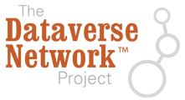
Elements of Our Approach
Defining & Measuring Privacy
  Mathematical, legal, statistical, experimental
Defining & Measuring Data Utility
  Replicating real studies on real data
Tools for Privacy
  Algorithms
  Legal instruments & best practices
Education & Outreach
  Open materials & videos
  Multidisciplinary training
Implemented on IQSS’
52,000 studies, 700,000 files.
Sociology, Political Science,
Economics, Psychology,
Anthropology, and
aspects of Public Policy, Education, Law, Public Health, History…
Notes:
There are several facets to our approach, ranging from definitional and experimental work with measures of privacy and utility, to the development of practical technological and legal tools for handling privacy sensitive-data, to making these tools and educational materials on privacy available for public use. I’ll talk about some of these in more detail later, but for now I want to highlight a unique opportunity in our project that comes from the IQSS Dataverse Network Project.
This is open source software, developed by IQSS, for data sharing, preservation, citation, and analysis, which is used to host virtual archives at universities around the world. In particular, the instance hosted at IQSS is the largest repository of social science data sets in the world, with approximately 52,000 studies and 700,000 files in a very diverse set of fields such as listed here.
By targetting the Dataverse Network, we have a real opportunity to get the tools we develop used in practice by social scientists. Our methods can be tested on real datasets, and tailored to needs and constraints relevant to real social scientists. And they will be integrated with a software infrastructure, provided by the dataverse network, that is already in wide use in social science and other disciplines. Indeed, we expect that much of our work will eventually be applicable beyond social science.
To summarize, our project aims to resolve the tension between privacy and open, replicable science
-> by bringing together leading researchers in the four key disciplines
-> to translate, adapt, & expand recent advances in CS and statistical theory into practices and tools in social science and law
-> thereby accelerating progress in all disciplines that are concerned with humans, human behavior, and human institutions

Slide 6
Defining and Measuring Privacy
Bridging Mathematical and Legal Definitions of Privacy
  Engage with revision of the “Common Rule”
  Bring CS insights to law & policy (and vice-versa)
    Expand conception of “data” beyond “microdata" (collection of person-specific records).
  Match protections with data type, sensitivity, context, consent…
Estimating Privacy Risk
  Develop new statistical and experimental methods to predict privacy risks and expose vulnerabilities
  Understand when does “worst-case” concept of differential privacy translate to real attacks, and when is it overly pessimistic.
Notes:
Our work on defining and measuring privacy has mathematical, legal, statistical, and experimental components, and I’ll just briefly mention a couple of aspects of it here.
One significant component of our work in this area will be to bridge the gap between the mathematical notions of privacy being developed in the computer science literature and legal conceptions of privacy as in existing regulation and scholarly writing. It is the perfect time to be doing this, as regulators are finally realizing that existing data privacy regulation is obsolete and needs major revision. In particular, within the past year, the US Department of Health and Human Services started a process to revise the Common Rule, which is the regulation that governs federally funded research with human subjects, and one of the goals is to better guide researchers and IRBs in dealing with data privacy issues. We submitted extensive comments on the advance notice of proposed rule-making, and plan to remain actively engaged with the policy process. The goal is to make sure policy-makers understand relevant insights from computer science and statistics, and conversely to use the values implicit in privacy regulation to shape the directions of computer science work.
Our statistical and experimental work on measures of privacy can be viewed as analogous to the role that cryptanalysis plays in evaluating the security of cryptographic algorithms. These approaches measure resilience to certain kinds of attacks, and thus provide upper bounds on the level of protection. This is complementary to the approach of differential privacy, which provides worst-case guarantees for all datasets and all kinds of attacks, but can potentially be overly pessimistic.

Slide 7
Privacy Tools: Algorithms
Theory, Design, and Testing
  Differentially private Zelig (unified framework for statistical estimation)
  Managing “privacy budget”
  Synthetic data/data summaries
  Data redaction and anonymization
Implementation and Deployment
  Secure implementations in Dataverse Network
  Enable wider access to privacy-sensitive data, beyond stringent access controls for raw data.
Notes:
A major component of our project is the design, testing, and implementation of algorithms for analyzing and sharing data in a privacy-protective manner.
One very promising direction here is the design of a private version of Zelig, which is a software package coauthored by our co-PI Gary King that provides a unified framework for a wide variety of statistical estimation algorithms, and is widely both within and outside social science. It turns out that this unified framework fits remarkably well with recent results in the differential privacy literature, due to Adam Smith, and so there is a chance of providing privacy for a wide range of analyses in one shot. Students from my group and co-PI Airoldi’s lab have done some preliminary experiments with this, and the results are encouraging.
Zelig is already integrated with the Dataverse Network software, meaning that researchers can run Zelig methods on the DVN servers without downloading the datasets. So if we succeed in making a private version of Zelig, we can also deploy it in the same way, and immediately put it into practice.
It is important to stress that we intend these methods as an *additional* mechanism for accessing privacy-sensitive data in the Dataverse Network, *not* as substitute for the standard approach where researchers can get the raw data through stringent access controls, often requiring IRB approval. The idea is that we will have a privacy-preserving interface that is available with little or no access control, where people will be able to perform analyses whose results are slightly distorted in some way in order to ensure privacy. After using such an interface to do preliminary work, an researcher may decide that it is worth going through the work of obtaining full access to the data via the access-control mechanisms.
Two other points I’d like to make here:
First, in addition to differentially private algorithms, we will also work on other types of redaction and anonymization algorithms, as co-Pis Sweeney and Airoldi have done in the past. This addresses one of the questions you had in your feedback.
Second, there is a range here from cases where we will be engineering and optimizing existing algorithms to make them practical to cases where entirely new algorithms need to be designed. To illustrate, we recently designed the first subexponential-time algorithm for producing a differentially private summary of a dataset that allows for estimating *all* multivariate marginal statistics. For example, our summary would let you estimate what fraction of individuals in the dataset smoke, AND don’t have cancer, AND are over 35 AND have any other attributes of interest? We plan to both implement and optimize this algorithm to see how it performs in practice, as well as continue the search for a polynomial-time algorithm (which would be a huge boon for private data analysis). I’ll be happy to talk about this in more technical depth later if you are interested.

Slide 8
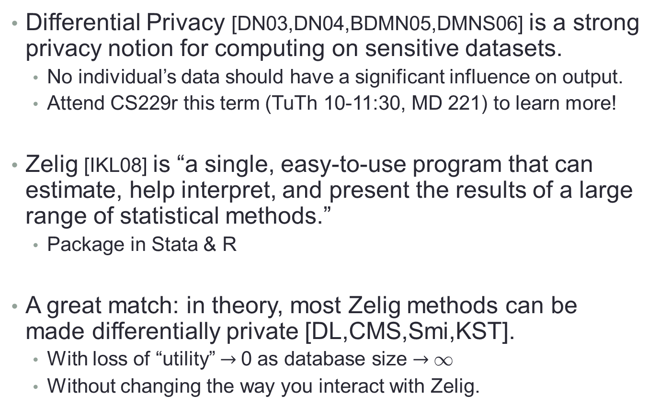
Differentially Private Zelig
Differential Privacy [DN03,DN04,BDMN05,DMNS06] is a strong privacy notion for computing on sensitive datasets.
  No individual’s data should have a significant influence on output.
  Attend CS229r this term (TuTh 10-11:30, MD 221) to learn more!
Zelig [IKL08] is “a single, easy-to-use program that can estimate, help interpret, and present the results of a large range of statistical methods.”
  Package in Stata & R
  A great match: in theory, most Zelig methods can be made differentially private [DL,CMS,Smi,KST].
  With loss of “utility” $→$0 as database size $→$1
  Without changing the way you interact with Zelig.

Slide 16
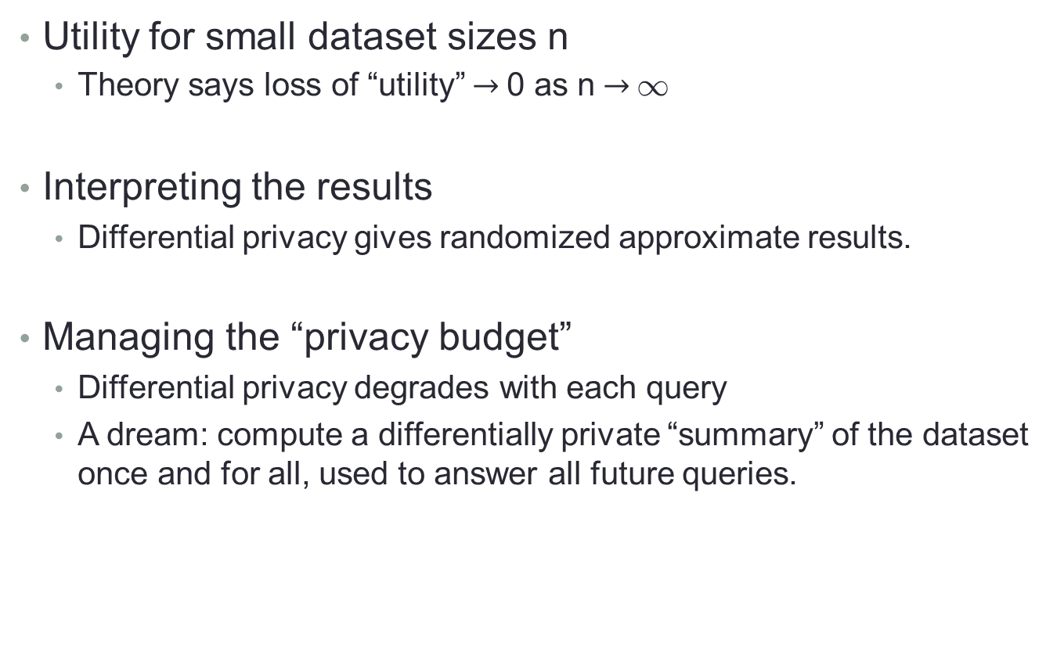
Differentially Private Zelig: Challenges
Utility for small dataset sizes n
  Theory says loss of “utility” $→$0 as n$→$1
Interpreting the results
  Differential privacy gives randomized approximate results.
Managing the “privacy budget”
  Differential privacy degrades with each query
  A dream: compute a differentially private “summary” of the dataset once and for all, used to answer all future queries.

Slide 17
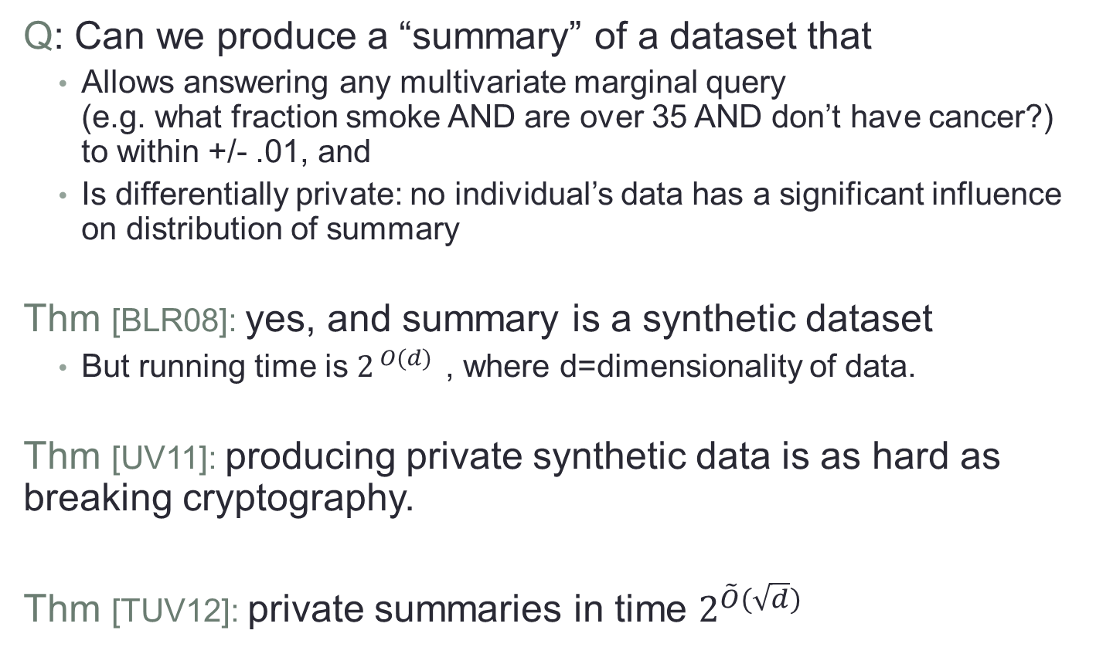
Private Data Summaries
Q: Can we produce a “summary” of a dataset that
  Allows answering any multivariate marginal query
  (e.g. what fraction smoke AND are over 35 AND don’t have cancer?)
  to within +/- .01, and
  Is differentially private: no individual’s data has a significant influence on distribution of summary
Thm [BLR08]: yes, and summary is a synthetic dataset
  But running time is $2^{ O(d) }$, where d=dimensionality of data.
Thm [UV11]: producing private synthetic data is as hard as breaking cryptography.
Thm [TUV12]: private summaries in time $2^{\tilde{O}(\sqrt{d})}$
Notes:
Here’s something that would be wonderful for private data analysis.
Given a dataset, we want to be able to produce a compact summary of it that,
First, allows one to answer any multivariate marginal query accurately – that is, from the summary, we can estimate the fraction of individuals in the dataset that have any desired collection of attributes, like what fraction are smokers, are over 35, and don’t have cancer.
Second, the summary itself is differentially private, meaning that no individual’s data has a significant influence on the summary.
This would be great. We can just publish this summary, or answer queries using this summary, and not worry about keeping track of how each query degrades privacy.
A beautiful result of Blum, Ligett, and Roth from a few years ago shows that this is indeed possible, and in fact their summary is a “synthetic dataset” – a fake dataset that has the same statistical properties as the original. Unfortunately, their algorithms runs in time exponential in the dimensionality of the data.
A result that I had last year with my student Jon Ullman showed that this exponential running time is necessary for *any* private algorithm that produces synthetic data, under standard cryptographic assumptions. But like many negative results in this area, this was not the end of the story. Instead it pointed us to look for other types of data summaries, and in fact we recently found one that we can construct in subexponential time (based on approximating boolean functions by real polynomials). This algorithm is relatively simple and we do plan to implement it and see how it performs in practice.
But a great open problem is whether the run time can be pushed all the way to polynomial, and is something that we plan to work on during the project.

Slide 18
Privacy Tools: Legal Instruments
Design Policies, Licenses, and Contracts to:
  Support computational privacy tools
  Obtain and communicate informed consent
  Ensure compliance with law & regulation
  Control use and sharing
Implementation
  Berkman Center Cyberlaw Clinic, led by co-PI Malone
    extensive experience in solving real-world privacy problems
    great educational experience for law students
  Machine-actionable “privacy tags” specifying terms of use
Notes:
Our work on computational tools for privacy will also be accompanied by the development of an array of legal instruments to assist researchers in handling privacy-sensitive data, through the full research pipeline, from obtaining consent when they collect data to the terms under which they share the data with other researchers, either directly or through our computational privacy tools.
This part of the project will be led by co-PI Malone and the Berkman Center Cyberlaw Clinic, which has extensive experience in working on such real-world privacy problems, including counseling researchers and others on data security, compliance with security and privacy laws, drafting privacy policies, and developing licenses and other legal instruments to protect sensitive. This is also a place where our project integrates very tightly with education, as Harvard Law students earn course credit for their work in the Clinic.
We also plan to create a creative-commons style framework for specifying privacy policies that can be automatically enforced, drawing upon co-PI Stephen Chong’s expertise on enforcing expressive information-flow policies.

Slide 21
Outreach and Education
Integration of research into courses
  Cyberlaw Clinic (Law School)
  Privacy & Technology (CS undergrad)
  Mathematical Approaches to Privacy (CS grad)
  Cyberspace in Court (Freshman seminar)
Open resources for practitioners & the public
  Edited & tagged course videos and open-access materials
  Access to more data in the IQSS Dataverse Network
  Menu of privacy algorithms, legal instruments, and best practices
  PrivacyScholar: case studies in privacy
  Reuters reporter Adam Tanner in residence at Data Privacy Lab
Research Training
  Multidisciplinary approach to data privacy
  REU site students, undergrad RAs, PhD students, postdocs
Notes:
On the education side, I’ve already talked about how the Cyberlaw Clinic will play a major role in our work. We also offer a variety of other privacy-related courses, which integrate with our research in a variety of ways, including course projects (in fact there have already been a couple of these in our preliminary work).
On the side of outreach, a major goal for our project is to generate a rich array of open resources for social science researchers, privacy practitioners, and anyone wishing to make better-informed decisions about privacy. For example, in addition to enabling more access to privacy-sensitive data in the IQSS Dataverse Network, we will also make our computational and legal privacy tools available as stand-alone open resources, which can be used by other researchers within and outside social science. We envision that a researcher confronted with a data privacy problem can develop an appropriate solution by selecting a subset of the tools as if ordering from a restaurant menu. Given the specific situation, the researcher can decide which is the appropriate consent form, which is the appropriate sharing mechanism, and what are the appropriate terms of use.

Slide 22
Outcomes
  Bridging mathematical & legal notions of privacy
  Engagement with policy process for privacy regulation
  New privacy definitions when existing ones insufficient
  New statistical measures of risk and utility
  Theoretical results on differential privacy & other notions
  Understanding practical performance of various algorithms
  New legal instruments for handling privacy-sensitive data
  Secure implementations of algorithms & legal instruments.
  Open resources for practitioners & the public
  Multidisciplinary research training
These efforts benefit, but are not reliant on, each other.
Notes:
As we’ve seen, our project has a variety of outcomes ranging from theory to practice, from computer science to law, from focused impact to broad outreach. All of these different aspects of our work mutually inform and benefit from each other, but none are dependent on very specific achievements in the others.

Slide 23
To get involved
  See http://privacytools.seas.harvard.edu/
  E-mail one of the PIs or privacytools-info@seas.harvard.edu
  Attend all-hands meetings (2nd Fri of each month, 2:30-4).
  We’re looking for people to work on the project:
    Research fellow in law & policy
    Undergraduate RA’s and REU students
    Project & communication coordinator
    HLS interns
    Graduate students in CS, statistics, quantitative social science
    Postdocs & visiting scholars
  And for present & future collaborators
    Do you have a data privacy problem?
Notes:
I’d like to conclude with a few thoughts about why we are embarking on this project.
Why do we feel it is important? We are motivated by the apparent clash between two values that we hold dear – the right to privacy on one side, and knowledge about humanity and human behavior on the other. Any progress we can make towards resolving this tension seems to be a valuable use of our time and resources.
Why is now the right time to do it? The new insights on data privacy that have been developing in computer science and statistics are why this project could not have been done 5 years ago, and the urgent need coming from computational social science (and big data more generally) is why we can’t wait any longer.
And why should we being doing this at Harvard, with our team? Our integrated multidisciplinary approach will allow for solutions that would not be possible when approaching the problem through the lens of a single discipline. Our team has already successfully started working together. And the IQSS Dataverse Network provides a unique opportunity for wide external impact.
We are now happy to take any questions you might have.

Slide 24
Why are we doing this?
Why is this important?
  Two values: privacy & knowledge.
Why do it now?
  Urgent need in computational social science.
  New insights from CS & stats
Why at Harvard?
  Integrated multidisciplinary approach
  Experienced team, already collaborating, with institutional support
  External impact through Dataverse Network
Notes:
I’d like to conclude with a few thoughts about why we are embarking on this project.
Why do we feel it is important? We are motivated by the apparent clash between two values that we hold dear – the right to privacy on one side, and knowledge about humanity and human behavior on the other. Any progress we can make towards resolving this tension seems to be a valuable use of our time and resources.
Why is now the right time to do it? The new insights on data privacy that have been developing in computer science and statistics are why this project could not have been done 5 years ago, and the urgent need coming from computational social science (and big data more generally) is why we can’t wait any longer.
And why should we being doing this at Harvard, with our team? Our integrated multidisciplinary approach will allow for solutions that would not be possible when approaching the problem through the lens of a single discipline. Our team has already successfully started working together. And the IQSS Dataverse Network provides a unique opportunity for wide external impact.
We are now happy to take any questions you might have.

