Slide 1

DataTags
Framework & Development
Mercè Crosas
Institute for Quantitative Social Science
David O’Brien
Berkman Center for Internet & Society
Privacy Tools for Sharing Research Data
Presentation to the National Science Foundation
December 1, 2014

Slide 2
Overview
Concept
Research and Development
Demo
Plans for the Future

Slide 3
Concept

Slide 4
Benefits of Sharing Data
Transparency
Collaboration
Research acceleration
Reproducibility
Data citation
Compliance with requirements from sponsors and publishers

Slide 5
Difficulty of Sharing Sensitive Data
Complexity of law
  Thousands of privacy laws in the US alone, at federal, state and local level, usually context-specific
  e.g., HIPAA applies only to covered entities (health plans, health care clearinghouses, and health care providers) and their business associates (legal, consulting, data aggregation, etc.)
Options available to researchers
  Restrict access under terms of a user agreement → very few people can access, and use restrictions may be unclear or overly constraining
  Share a deidentified dataset → many people can access, but often utility is reduced and/or privacy protection is ineffective
  Not share at all → nobody can access

Slide 6
How about providing a tool that generates
a policy for your sensitive data
that defines how to transfer, store,
access and use those data?
. . . and DataTags was born

Slide 7
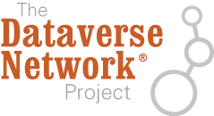
Integration of Tools
Risk Assessment and
De-Identification
Open Access to
Sanitized Data Set
Deposit in repository
IRB proposal & review
Consent from subjects
Data Set
Data Tag Generator
Differential Privacy
Query Access
Policy Proposals and Best Practices
Database of Privacy Laws & Regulations
Customized & Machine-Actionable
Terms of Use
Restricted Access

Slide 8

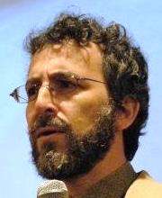


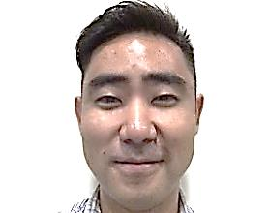

















Building DataTags:
A necessary collaboration
Legal Expertise
Computer
Science
Expertise
Data
Stewardship
Expertise

Slide 9
We benefited from …
Initial work from Latanya Sweeney to group the vast array of federal and state privacy laws into ~ 30 general classifications
Security levels set by Harvard University for confidential information:
Level 1 | Non-confidential research information Public information
Level 2 | Benign information to be held confidentially Information the disclosure of which would not cause material harm, but which the University has chosen to keep confidential
Level 3 | Sensitive or confidential information Information that could cause risk of material harm to individuals or the University if disclosed
Level 4 | Very sensitive information Information that would likely cause serious harm to individuals or the University if disclosed
Level 5 | Extremely sensitive information Information that would cause severe harm to individuals or the University if disclosed

Slide 10
DataTags Design Goals
Define simple, iconic labels (tags) to set requirements for transmitting, storing and using the dataset.
Construct a decision graph to map legal restrictions to dataset properties
Automate a user-friendly interview to elicit properties of the data and the collector from the user
Generate a final report with machine-actionable tags and related documentation
Interoperate with data repositories (e.g., Dataverse)

Slide 11
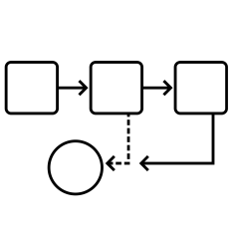

How DataTags Works
Step 1
Dynamic Questionnaire
DataTags elicits key properties of a given dataset by asking the user a sequence of questions that adjusts based on the user’s answers
Step 2
Inference
Based on the user’s responses to the questionnaire, DataTags applies inference rules to determine which legal restrictions are applicable and therefore which data handling tags should be assigned
Step 3
Assignment
DataTags generates simple, iconic tags that indicate how the dataset can be stored, transmitted, or used based on the dataset’s properties and applicable legal restrictions

Slide 12
Draft Tag Levels
blue
Non-confidential information that can be stored and shared freely
green
Potentially identifiable but not harmful personal information, shared with some access control
yellow
Potentially harmful personal information, shared with loosely verified and/or approved recipients
orange
May include sensitive, identifiable personal information, shared with verified and/or approved recipients under agreement
red
Very sensitive identifiable personal information, shared with strong verification of approved recipients under signed agreement
crimson
Requires explicit permission for each transaction, using strong verification of approved recipients under signed agreement

Slide 13
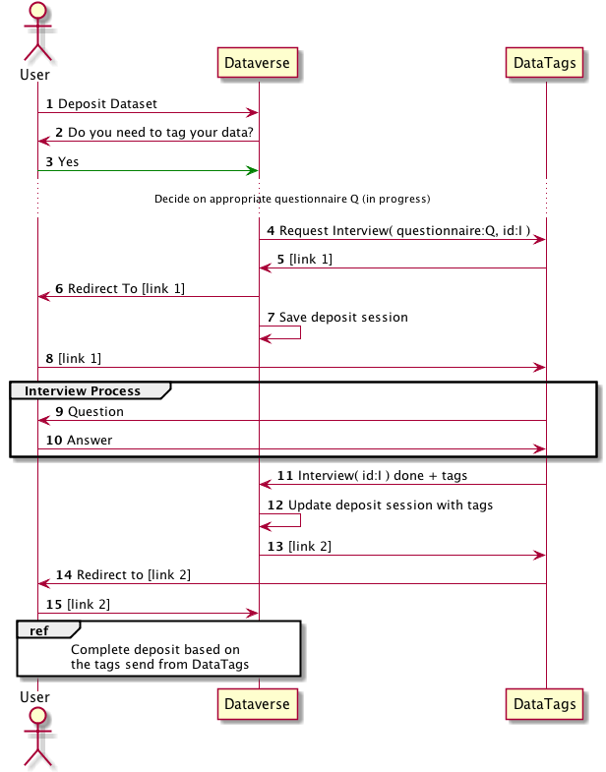
DataTags
API
REU
Project

Slide 14
Research and Development

Slide 15
Integration of Tools
Risk Assessment and
De-Identification
Open Access to
Sanitized Data Set
Deposit in repository
IRB proposal & review
Consent from subjects
Data Set
Data Tag Generator
Differential Privacy
Query Access
Policy Proposals and Best Practices
Database of Privacy Laws & Regulations
Customized & Machine-Actionable
Terms of Use
Restricted Access

Slide 16



Scope
Medical records
HIPAA Privacy Rule
Substance abuse confidentiality regulations
Student records
FERPA
Protection of Pupil Rights Amendment
Education Sciences Reform Act
Government records
Privacy Act of 1974
Confidential Information Protection and Statistical Efficiency Act
Title 13 (Census Bureau)
Driver’s Privacy Protection Act

Slide 17
Legal Research Objectives
1. To better understand
  data sharing challenges,
  flows of information,
  the regulatory framework, and
  common institutional and contractual approaches
  2. To identify typologies of
    regulatory and contractual requirements, and
    common practices from different disciplines

Slide 18
How DataTags Works
Step 1
Dynamic Questionnaire
DataTags elicits key properties of a given dataset by asking the user a sequence of questions that adjusts based on the user’s answers
Step 2
Inference
Based on the user’s responses to the questionnaire, DataTags applies inference rules to determine which legal restrictions are applicable and therefore which data handling tags should be assigned
Step 3
Assignment
DataTags generates simple, iconic tags that indicate how the dataset can be stored, transmitted, or used based on the dataset’s properties and applicable legal restrictions

Slide 19
Legal Research Activities
Legal memoranda and whitepapers analyzing
  Privacy statutes, regulations, case law, agency and institutional interpretations of laws
  Definitions of personally identifiable information and examples of sensitive information from different laws and regulations
  IRB and university data classification policies
  Common contractual approaches to data sharing
2014 Summer Interns

Slide 20
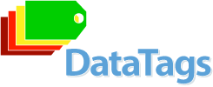

Research Integration
Questionnaire
Implementation
&
Refinement
Legal Research
Inference Rules
Tagging Framework

Slide 21
Questionnaire Development
Identifying regulatory and contractual requirements most relevant to research data sharing
Clustering legal requirements and approaches into general categories
Drafting annotated DataTags questionnaires
Supporting implementation process

Slide 22
Annotated Questionnaires
Question (written in lay terms)
Defined terms
Examples of information for each definition
Citations to and excerpts of legal authority
Interpretations from case law, agency policies, and the policies of a variety of institutions
Tags to be assigned based on answers given (and how they should be interpreted)
Rationale (why the question is included, written the way it is, and how it translates and reconciles different legal interpretations)

Slide 23
Example Question: “education records”
Do the data contain any information derived from institutional records directly related to a student? This refers to records maintained by an educational agency or institution, or by a person on behalf of the agency or institution, for each student in the normal course of business. For the purposes of this questionnaire, information may satisfy this definition even if it has been deidentified.
Examples of records directly related to a student include:
Directory information such as name, address, telephone listing, e-mail address, date and place of birth, dates of attendance, number of course units in which enrolled, class level, major field of student, last school attended, degrees and honors received, participation in official student activities, and student athletes’ weight and height
Demographic information such as gender, race, ethnicity, nationality, citizenship
Identification photographs
Current academic status, class schedule, courses taken, academic specialization and activities, units attempted and completed, instructors, past academic status, official communications regarding academic status
Academic evaluations, including student examination papers, transcripts, grade point average, grades in courses, test scores, recorded communications that are part of the academic process, and other academic records
…
Examples of records not directly related to a student include:
Personal memory aids held in the sole possession of their creator (such as a teacher’s notes)
Records maintained by the law enforcement division of an educational agency or institution
Employment records for an educational agency or institution
Records produced by a physician, psychiatrist, or other professional for treatment purposes
Grades on peer-graded papers before a teacher has recorded them
Records directly related to other individuals, such as records of teacher misconduct or complaints against school employees, that only tangentially refer to students
Information obtained from observation and not from an education record

Slide 24
Usability Testing
Feedback received from 6 groups of potential DataTags users, including researchers, repositories, and academic journals
Report compiling and analyzing recommendations from users:
    More detailed documentation to explain the concept
    Increased transparency into the tagging process
    Enhanced definitions and examples to minimize ambiguity
Revisions based on feedback incorporated in DataTags v. 1.0

Slide 25
Demo

Slide 26
Hypothetical Dataset
The dataset contains information collected in a 10 year longitudinal health and education study. The research is conducted by academic researchers and funded by their university and a private foundation (however, no government funding is involved)
Subjects: public school students in grades 6-12. Parents received notice and provided written consent.
Dataset contains:
  grades collected pursuant to transcript requests
  responses to questionnaires distributed at school that cover sensitive topics, such as drug and alcohol use
  biomarkers like blood pressure and heart rate
  direct identifiers, such as names and addresses have been removed, but indirect identifiers such as gender, race, height, weight, and ZIP code remain

Slide 27
Plans for the Future

Slide 28
Plans for the Future
Conduct additional usability testing and outreach
Add support for data use agreements, consent terms, and IRB policies
Improve assessment of identifiability, sensitivity, and the effectiveness of deidentification
Improve harmonization of approaches across different areas of law
Develop a modular license generator
Integrate with repository (Dataverse) and differential privacy tools
Add formal verification, validation, and optimization theory and tools

