Slide 1
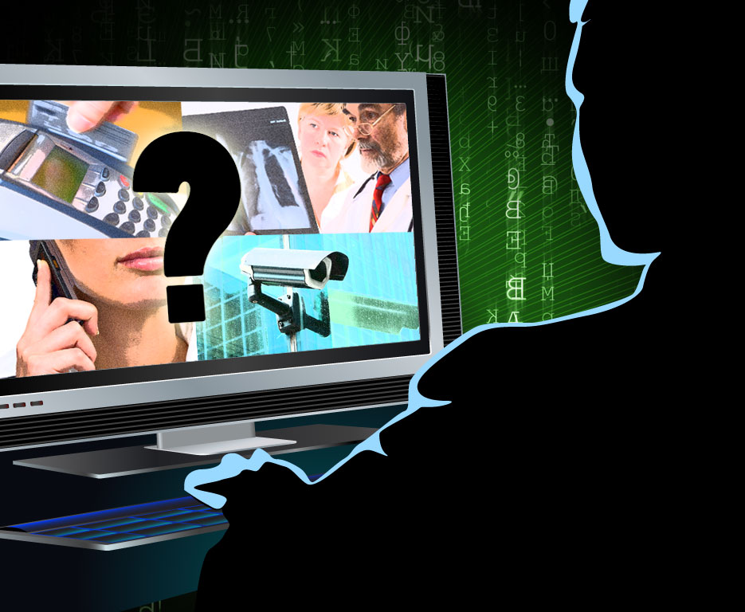
Privacy TOOLS FOR SHARING RESEARCH DATA
NSF Secure & Trustworthy Cyberspace
PI Meeting
January 9, 2017
Salil Vadhan
Harvard University

Slide 2
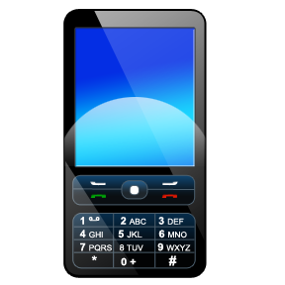
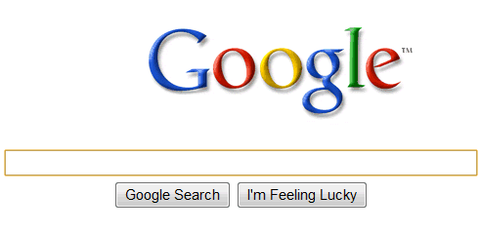


Computational Social Science
The potential: massive new sources of data and ease of sharing will revolutionize social science.
The problem: protecting the privacy of individual subjects
utility
traditional approaches
(e.g. “stripping PII”)
privacy
open data
privacy
e.g. NYT 5/21/12 “Troves of Personal Data, Forbidden to Researchers”
Notes:
The context for our project is the exciting transformation that is happening in social science, due to the immense variety and volume of new sources of data on human behavior. Instead of being limited to surveys of a few thousand people, researchers can carry out studies on the scale of hundreds of thousands by using data from new sources such as cell phone GPS readings, web searches, political blog posts, and social network activity. Moreover, the internet and data repositories such as the Dataverse Network (which I’ll talk about later) have made it much easier to share such data with other researchers enable replication and new analyses.
However, a major obstacle for realizing the full potential of this vision is Privacy. Most of these datasets contain sensitive personal information about individuals, and currently social scientists do not have the tools to ensure that the privacy of those individuals is protected when the data is analyzed or shared. The result is that researchers are refusing to share their data, clashing with the growing movement towards open sharing of data being pushed by the research community and funding agencies.
What do about this? The traditional approach is to try and anonymize data by removing so-called “personally identifying information”. However, it is now well-known that this technique does not work, because moderate amounts of seemingly innocuous information can already uniquely isolate individuals, and this information can often be linked with other publicly available data to re-identify the individuals in supposedly anonymized datasets. This problem was demonstrated in work by my co-PI Latanya Sweeney a number of years ago linking anonymized medical claims data with public voter registration rolls to uniquely identify the record of Massachusetts governer William Weld, and has become much more acute with the vast amounts of data that is publicly available on the internet. Indeed, there have been many more examples of reidentifications since then.
Thus, this traditional approach presents us with a stark choice between privacy and data utility. If you remove only obviously identifying information, then the privacy is very weak – you’ve just made it slightly harder to identify individuals. If you aggressively de-identify, then the resulting dataset may have very little utliity left – you may have removed exactly the information you are interested in studying.

Slide 3
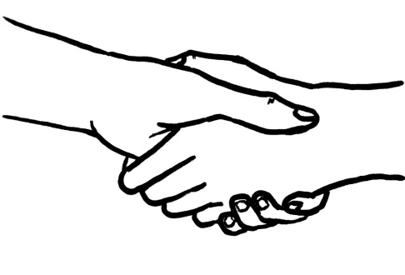
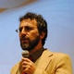




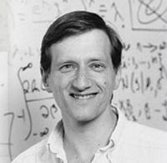





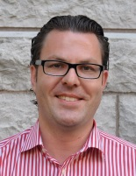
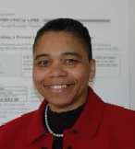







Our Goal
utility
Achieve:
privacy
&
open data
Program on Information Science
MIT Libraries
Nissim
(Georgetown)
privacy
Via:
Altman
social
science
Honaker
Chong
Vadhan
King
Crosas
computer
science
data science
Gasser
Sweeney
Airoldi
Gaboardi
(Buffalo)
law &
policy
O’Brien

Slide 4
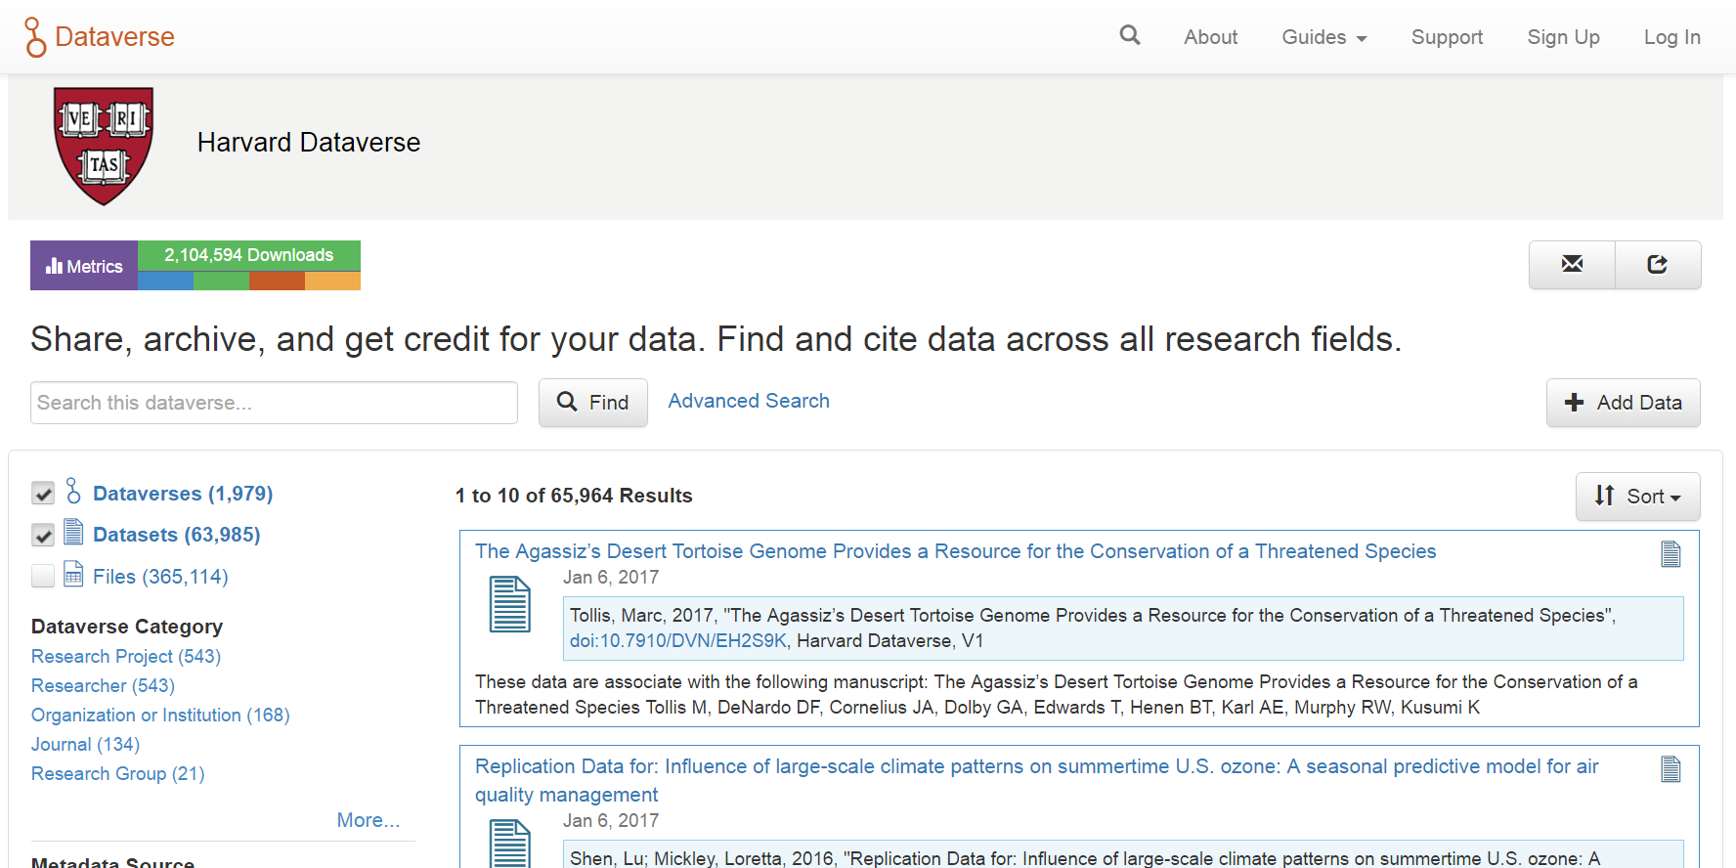
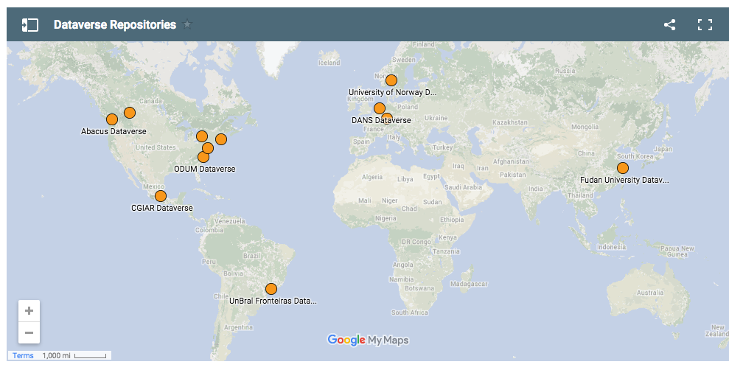
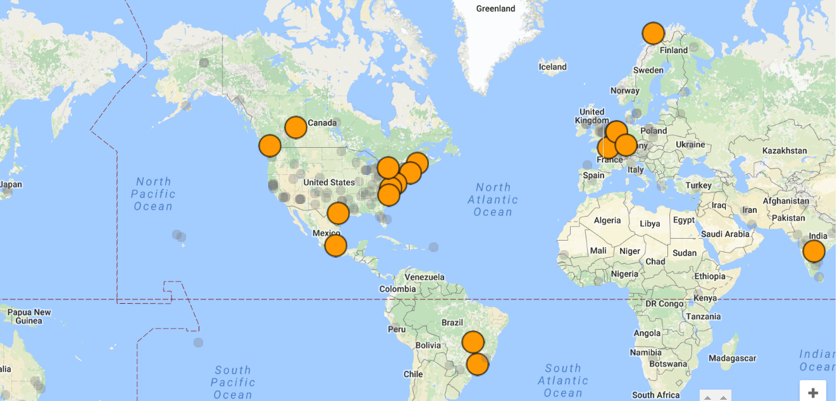
Target: Data Repositories
Dataverse Repositories around the world:
21 installations
Harvard Dataverse Repository:
1274 dataverses with 59,265 datasets
and 1,415,241 downloads
Largest social science repository in the world
Notes:
Stress = wide use of datavsrse. 10 repositories around the world, ¾ million files. Harvard dataverse has served 1m+ downloads.
NEED TO UPDATE SCREENSHOT.

Slide 5
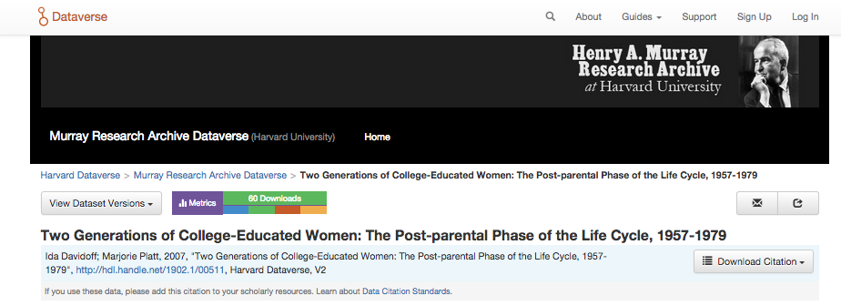
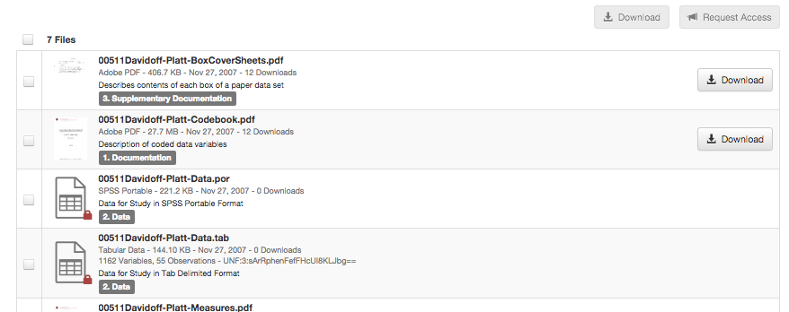
Datasets are restricted due to privacy concerns
Goal: enable wider sharing while protecting privacy

Slide 6
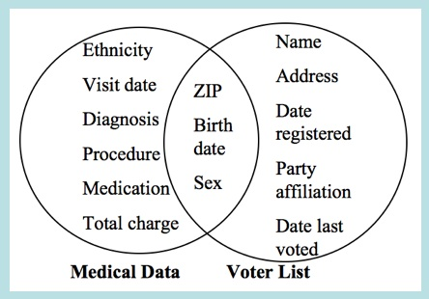
Challenges for Sharing Sensitive Data
Complexity of Law
Thousands of privacy laws in the US alone, at federal, state and local level, usually context-specific:
HIPAA, FERPA, CIPSEA, Privacy Act, PPRA, ESRA, ….
Difficulty of Deidentification
Stripping “PII” usually provides
weak protections and/or poor utility
Inefficient Process for Obtaining Restricted Data
Can involve months of negotiation between institutions, original researchers
Vision: array of
computational, legal, policy tools that make
privacy-protective data-sharing easier for researchers without expertise in privacy law/cs/stats.
Sweeney `97
Notes:
This is the challenge. General-purpose environment.

Slide 7

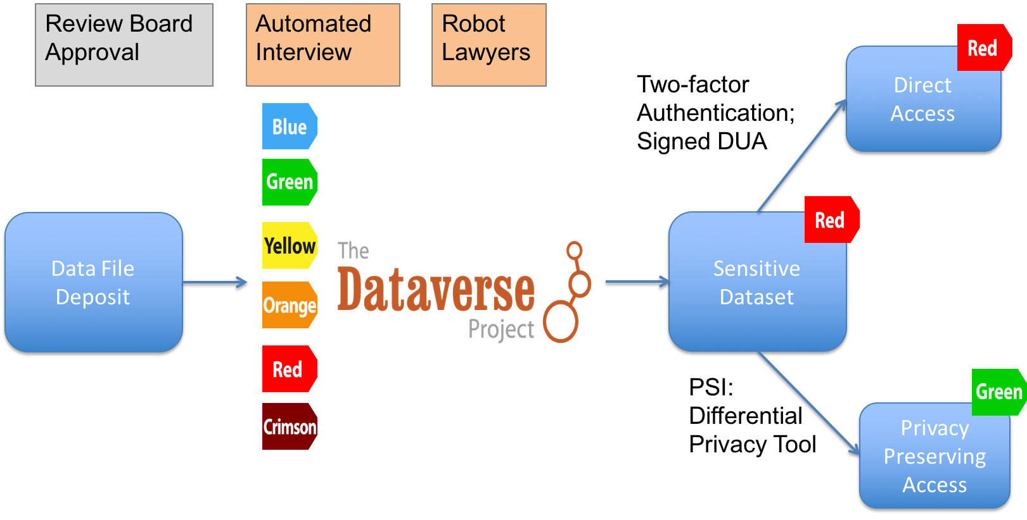
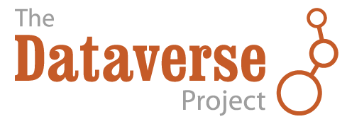
Approach: Integrated Privacy Tools
RestrictedAccess
Data Set w/DUA
Robot
Lawyers
Deposit in repository
Sensitive
Data Set
DataTags Interview
Sensitive
Data Set
PSI:
Differential
Privacy
Tools we are working on
Public Access Statistics
Notes:
Stress that while this is a focusing vision, our work in each area also stands alone.

Slide 8
DataTags Tools
RestrictedAccess
Data Set w/DUA
Robot
Lawyers
Deposit in repository
Sensitive
Data Set
DataTags Interview
Sensitive
Data Set
PSI:
Differential
Privacy
Help generate policies for how to transfer, store, access, and use
a sensitive dataset.
Public Access Statistics
Notes:
Stress that while this is a focusing vision, our work in each area also stands alone.

Slide 9
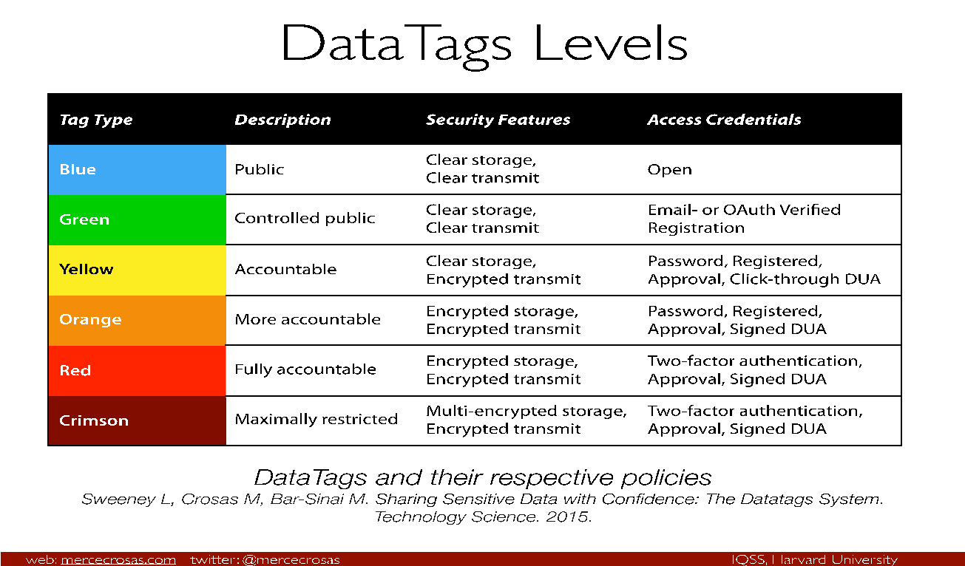
Basic DataTags Levels

Slide 10
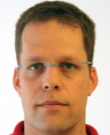
Basic DataTags Levels
social
science
Crosas
computer
science
data science
Sweeney
Bar-Sinai
law &
policy

Slide 11
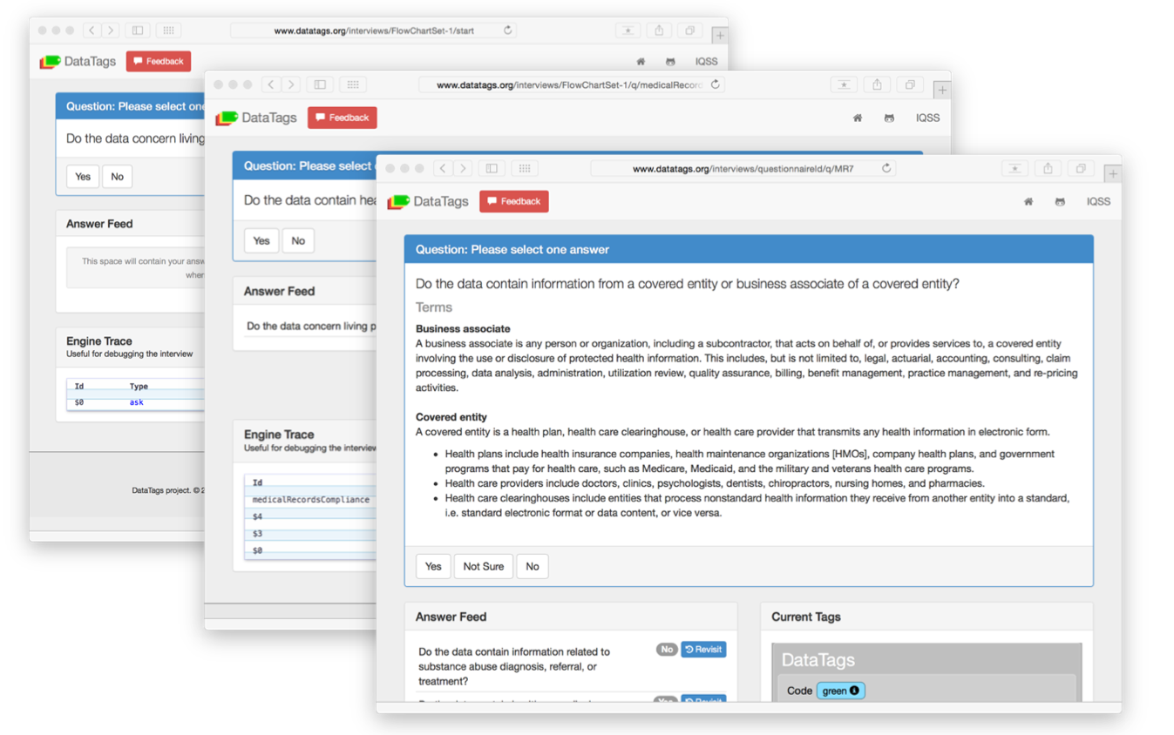
DataTags Interviews

Slide 12
Robot Lawyers
Sensitive
Data Set

Slide 13
Robot Lawyers

Slide 14
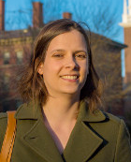
Robot Lawyers Team
Program on Information Science
MIT Libraries
Altman
social
science
Chong
& students
Shaw,
Bembenek,
Wang
computer
science
data science
law &
policy
Wood

Slide 15
Approach: Integrated Privacy Tools
RestrictedAccess
Data Set w/DUA
Robot
Lawyers
Deposit in repository
Sensitive
Data Set
DataTags Interview
Sensitive
Data Set
PSI:
Differential
Privacy
Tools we are working on
Public Access Statistics
Notes:
Stress that while this is a focusing vision, our work in each area also stands alone.

Slide 16
Approach: Integrated Privacy Tools
RestrictedAccess
Data Set w/DUA
Robot
Lawyers
Deposit in repository
Sensitive
Data Set
DataTags Interview
Sensitive
Data Set
PSI:
Differential
Privacy
Tools we are working on
Public Access Statistics
Notes:
Stress that while this is a focusing vision, our work in each area also stands alone.

Slide 17

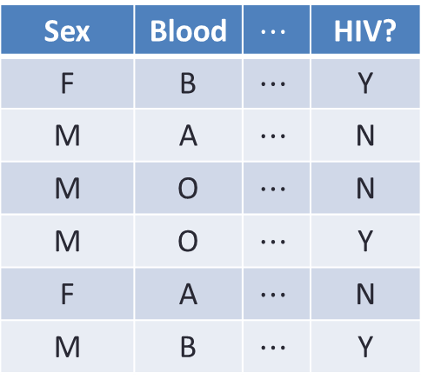
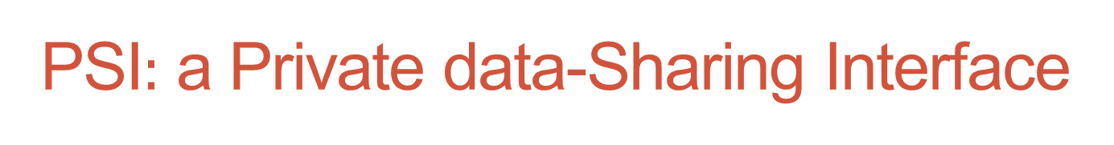
PSI$:$ a Private data-Sharing Interface
C
Sex | Blood | $$⋯$$ | HIV?
F | B | $$⋯$$ | Y
M | A | $$⋯$$ | N
M | O | $$⋯$$ | N
M | O | $$⋯$$ | Y
F | A | $$⋯$$ | N
M | B | $$⋯$$ | Y
q₁
a₁
q₂
$$Ψ$$
a₂
q₃
a₃
interface
data analysts
Provides differential privacy: hides effect of each individual
[Dinur-Nissim ’03+Dwork, Dwork-Nissim ’04, Blum-Dwork-McSherry-Nissim ’05,
Dwork-McSherry-Nissim-Smith ’06]

Slide 18
Goals of PSI
General-purpose: applicable to most datasets in repository.
Automated: no differential privacy expert optimizing algorithms for a particular dataset or application
Tiered access: DP interface for wide access to rough statistical information, helping users decide whether to apply for access to raw data
(cf. Census PUMS vs RDCs)

Slide 19
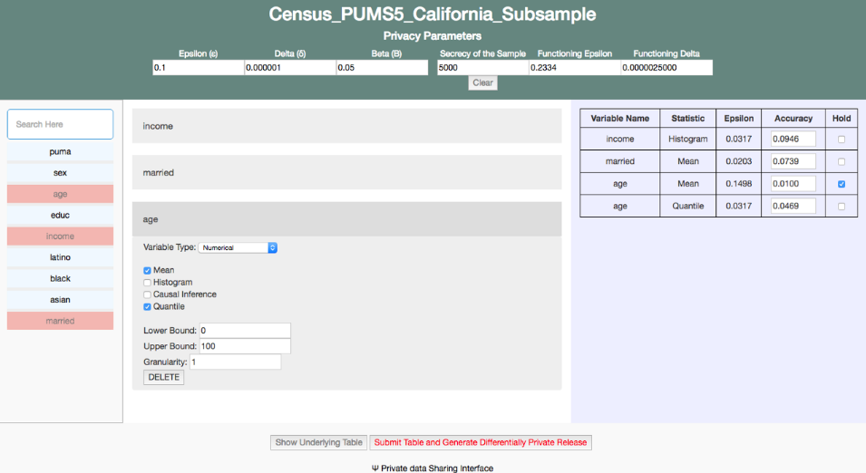
Privacy Budgeting Interface

Slide 20
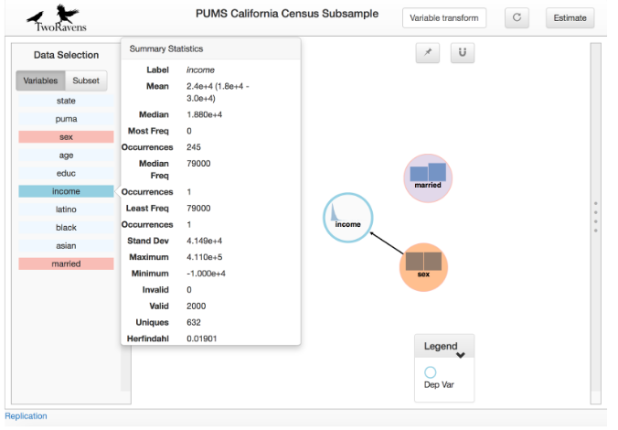
Integration with Statistical Tools for Social Science

Slide 21


PSI Team Leadership
Ullman
(Northeastern)
Nissim
(Georgetown)
privacy
social
science
Honaker
Vadhan
King
computer
science
data science
Murtagh
Gaboardi
(Buffalo)
law &
policy

Slide 22
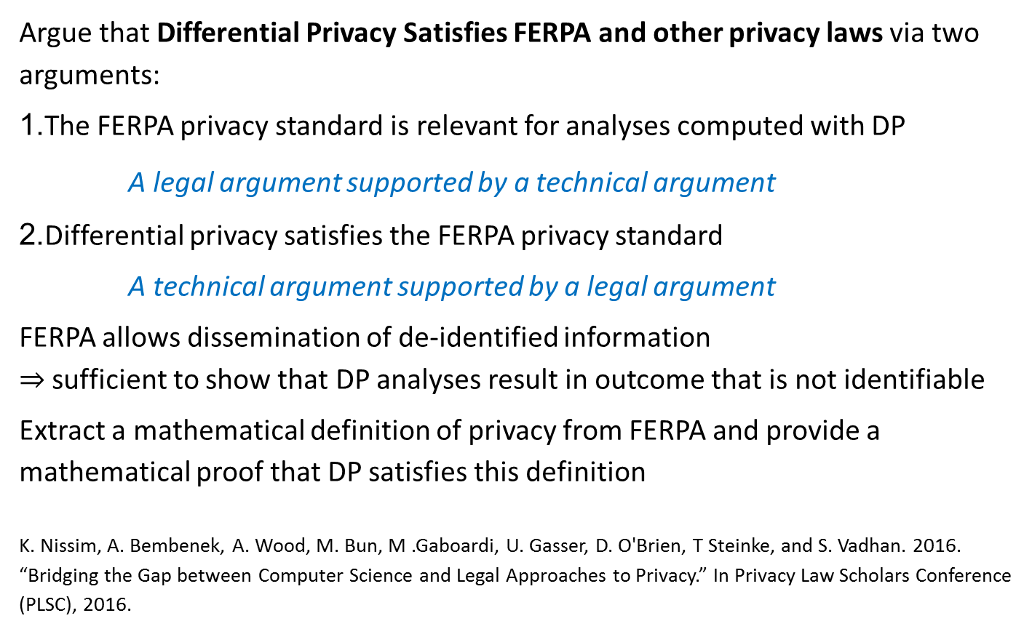
Bridging Law and CS Definitions of Privacy
Argue that Differential Privacy Satisfies FERPA and other privacy laws via two arguments:
1.The FERPA privacy standard is relevant for analyses computed with DP
A legal argument supported by a technical argument
2.Differential privacy satisfies the FERPA privacy standard
A technical argument supported by a legal argument
FERPA allows dissemination of de-identified information
$⇒$ sufficient to show that DP analyses result in outcome that is not identifiable
Extract a mathematical definition of privacy from FERPA and provide a mathematical proof that DP satisfies this definition
K. Nissim, A. Bembenek, A. Wood, M. Bun, M .Gaboardi, U. Gasser, D. O'Brien, T Steinke, and S. Vadhan. 2016. “Bridging the Gap between Computer Science and Legal Approaches to Privacy.” In Privacy Law Scholars Conference (PLSC), 2016.

Slide 23



Bridging Law and CS Definitions of Privacy
Nissim
(Georgetown)
Bun
Steinke
social
science
Chong
Vadhan
computer
science
data science
Bembenek
Gaboardi
(Buffalo)
law &
policy
O’Brien
Wood
Gasser

Slide 24
Broader Impacts: Overarching Goals
Exposing a multidisciplinary understanding of data privacy to a wide range of audiences (students, policymakers, public)
Bringing integrated solutions to data privacy problems to practice (focusing on data repositories and computational social science)

Slide 25

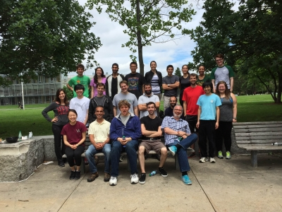
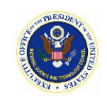
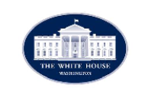


Broader Impacts
Infrastructure for research
in social science and other
human subjects research fields
Training in multidisciplinary research:
≈100 students, postdocs, interns from
law, computer science, social science, stats
Policy impact: White House Big Data Privacy Study, National Privacy Research Strategy, NIST 800-188 Deidentifying Government Datasets, …

Slide 26
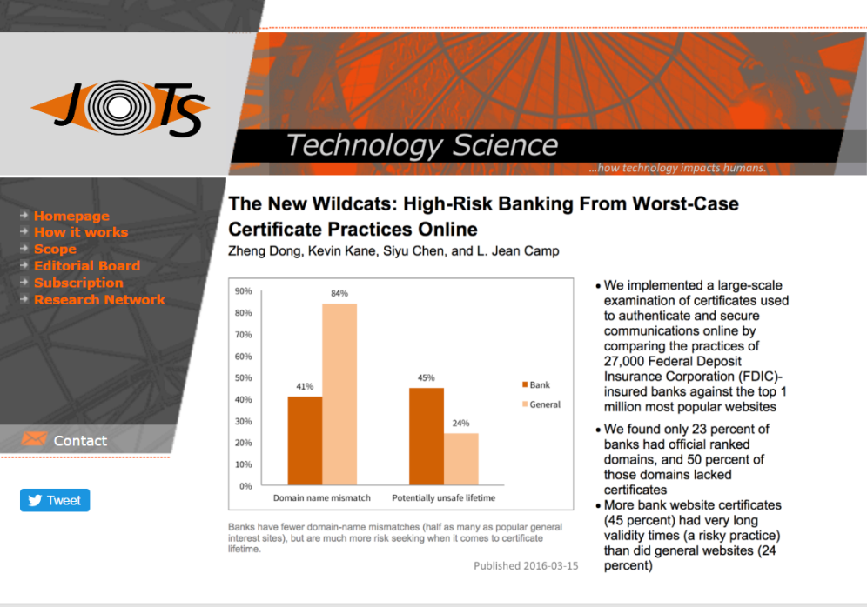

Broader Impacts
Numerous workshops and symposia
including public symposium with
700+ registrants.
New journal “Technology Science”
utilizing DataTags
Open-access pedagogical materials on data privacy for many audiences

Slide 27
Other Accomplishments
Many theoretical results illuminating the limits of differential privacy (lower bounds, algorithms, hardness results, attacks).
Bridging differential privacy & statistical inference
(confidence intervals, hypothesis testing, Bayesian sampling)
Framework for modern privacy analysis: catalogue privacy controls, identify information uses, threats, and vulnerabilities, and design data programs that align these over data lifecycle.

Slide 28
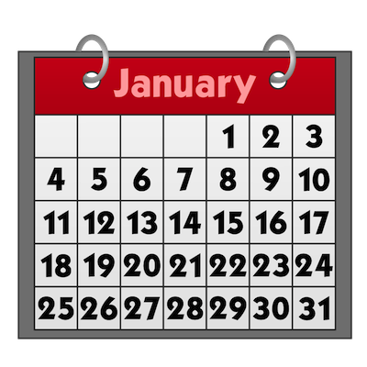
What’s Next
Rest of Frontier project (next 9 months):
  Transition to Practice: several tools deployed for sharing of sensitive datasets in the Harvard Dataverse
  Dissemination: write, publish, and present our work for all of the relevant communities (including potential users)
Beyond the Frontier project:
  “Computing over Distributed Sensitive Data” (NSF SaTC Large)
  “Applying Theoretical Advances in Privacy to Computational Social Science Practice” (Sloan Foundation)
  “Formal Privacy Models and Title 13” (Census)
  Production-level Tools for long-term, wide use (in planning)
For more info: Tuesday poster session (46-B-R)
and http://privacytools.seas.harvard.edu/

