Slide 1
Bridging Notions of Privacy
(a.k.a. de-identification WG)
Kobbi Nissim
(BGU and CRCS@Harvard)
Privacy Tools for Sharing Research Data
NSF site visit, October 2015

Slide 2
WG Goals
Help Dataverse depositors navigate the complex privacy landscape (hence, enabling more sharing)
  “Pedagogical document”
    Excerpts may be integrated with a future tagging system
Bridging law and mathematical definitions of privacy
  In what sense does differential privacy satisfy the language of the law?
Building our own common understanding of legal and technological aspects of privacy

Slide 3
Who?
Discussion open to all
CRCS: Kobbi Nissim (lead), Salil Vadhan, Marco Gaboardi; Post doctoral researcher: Or Sheffet; Ph.D. Students: Thomas Steinke, Mark Bun, Aaron Bembenek; REU students
Berkman: Alex Wood, David O’Brien; Ph.D. Student: Ann Kristen; Law students
IQSS: Deborah Hurley
Visitors:
  Latanya Sweeney (Harvard), Vitaly Shmatikov (Cornell), Micah Altman (MIT), Sonia Barbosa (Harvard)
Notes:
Sonia Barbosa: Curator Murray Research Archive, permanent repository for quantitative and qualitative research data at the Institute for Quantitative Social Science, over 125 terabytes of data, audio, and video.

Slide 4

The Pedagogical Document

Slide 5
Pedagogical document
Goal: Help social scientists (Dataverse depositors) navigate the complex privacy landscape
Target audience: Social scientists conducting studies using personal information
Format: collection of 3-4 documents,
  Importance of data privacy, implications of privacy breaches
  Relevant laws and best practices
  Common de-identification methods and re-identification risks
  Differential privacy
Planned use:
  Stand alone documents
  Language to explain topics to future Dataverse users as they consider whether and how to use tools developed in the Privacy Tools project
~ Dec ‘15
~ Nov ‘15

Slide 6
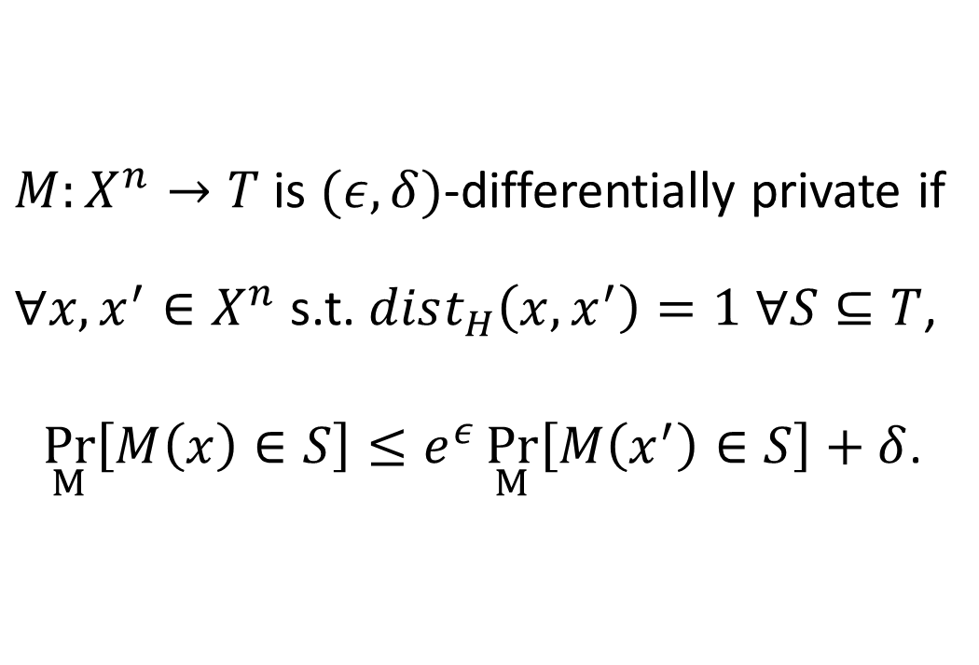
Pedagogical document (DP)
$M:X^{n}→T$ is $(ε, δ)$-differentially private if
$∀x,x^{′}∈X^{n}$ s.t. $dist_{H}\left(x,x^{′}\right)=1$ $∀S⊆T$,
$\underset{M}{Pr}\left[M\left(x\right)∈S\right]≤e^{ε}\underset{M}{Pr}\left[M\left(x^{′}\right)∈S\right]+δ$.
Not this way:

Slide 7
Pedagogical document (DP)
Structure:
Introduction
What is the differential privacy guarantee?
The privacy loss parameter
How does differential privacy address privacy risks?
Differential privacy and legal requirements
How are differentially private analyses constructed?
Limits of differential privacy
Tools for differentially private analyses
Summary
Further discussion
Further reading
Simple language and technical terms
  But mathematically accurate and factual
Illustrative examples
  What is the privacy guarantee?
  Demonstration of differencing attack
  Interpreting risk via replacing probability with dollar amounts
  …
Incorporated feedback from our social science REU students

Slide 8
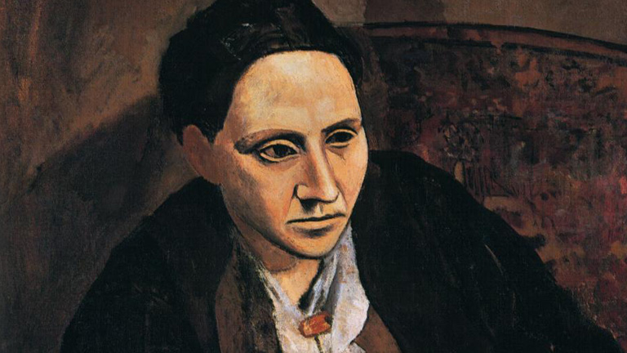
An Example: Gertrude’s Life Insurance
Gertrude is 65, her life insurance policy is $100,000, considers her risks from participating in a medical study performed with DP
Gertrude baseline risk:
  1% chance of dying next year, “fair premium” $1,000
  Gertrude is a coffee drinker, if study shows 65-year-old female coffee drinkers have 2% chance of dying next year, her “fair premium” would be $2,000
  Gertrude worried that the study may reveal more – maybe she has a 50% chance of dying, would that increase her premium from $2,000 to $50,000?
Reasoning about Gertrude’s risk
  Study done with ε=0.01
  Insurance company’s estimate of Gertrude's dying probability can increase to at most
  (1+ ε)⋅ 2 = 2.02%
  “Fair premium” would increase to at most $2,020, Gertrude’s risk would be at most $20
What have we done?
  Simplified but somewhat realistic situation
  Translated a complicated notion of probability to an easier to understand dollar amounts
  Provided a table for performing similar calculations (w/varying values of posterior beliefs and ε)

Slide 9
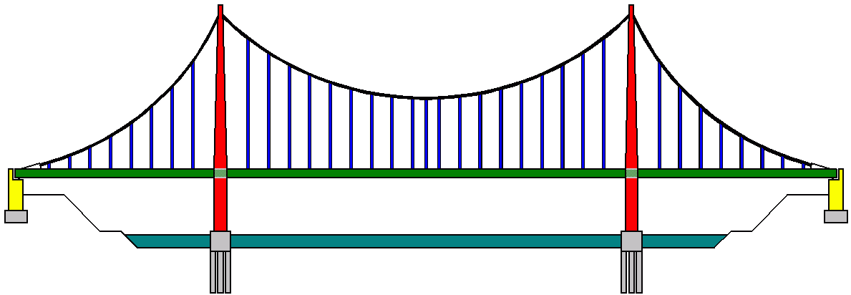
Exploring/bridging law and mathematical definitions of privacy

Slide 10
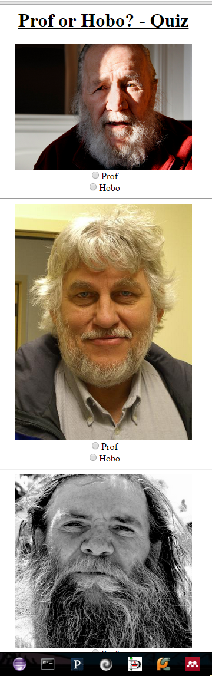
Does differential privacy satisfy the legal privacy standards?
Why ask?
  Essential for making differential privacy usable!
De-identification is only technique specifically endorsed by standards like FERPA and HIPAA
  E.g., HIPAA’s Safe Harbor method: Remove all 18 listed identifiers
No clear standard w.r.t. other techniques
  HIPAA’s Expert Determination method: Obtain confirmation from a qualified statistician that the risk of identification is very small
    Who is an expert?
    How should s/he determine that the risk is small?
      We’re here to help!
Notes:
De-identification in FERPA

Slide 11
A gap to be bridged

Slide 12
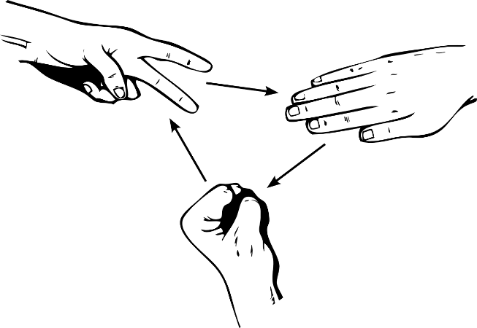
CS paradigm of security definitions
Security defined as a game with an attacker
Attacker defined by:
  Computational power (how much resources such as time, memory, it can spend)
  External knowledge it can bring from “outside the system” (aka auxiliary information)
  Not a uniquely specified attacker, but a large family of potential attackers
    Capture all “plausible” misuses
Game defines:
  Access to the system
  What it means for an attacker to win
System secure:
  If no attacker can win “too much”

Slide 13
Privacy definitions in FERPA/HIPAA/…
Not technically rigorous, open for interpretation
Refer to the obvious extreme cases, not to the hard to determine grey areas
Advocate redaction of identifying information
  Not as clear about other techniques
No explicit attacker model, but regulations do contain hints:
  Who is the attacker?
  What would be considered a win?

Slide 14
Opportunities for Bridging the Gap
Many shared goals:
  Understanding privacy
  Minimizing harms from data usage while obtaining as much utility as possible
Differential privacy:
  Not conforming to regulation would be a barrier for usage
Law and regulation:
  Need to understand technology to approve its use

Slide 15
Bridging the legal and CS views
BAD!
copy input to output
redact this
Good?
analyses
it depends...

Slide 16
Bridging the legal and CS views
BAD!
copy input to output
redact this
Good?
analyses
it depends...

Slide 17
Bridging the legal and CS views
BAD!
copy input to output
redact this
Good?
analyses
it depends...

Slide 18
Bridging the legal and CS views
BAD!
copy input to output
redact this
Good?
analyses
it depends...

Slide 19
Methodology:
BAD!
copy input to output
DP
redact this
Good?
analyses

Slide 20
Methodology:
Search explicit requirements and hints on attacker model
  E.g., FERPA defines attacker as “A reasonable person in the school community that does not have personal knowledge of the relevant circumstances”
  Directory information can be made public
  Attacker’s goal: identification of sensitive (non-directory) data
  Etc.
Create a formal mathematical attacker model for the regulation
  Always err on the conservative side
Provide a formal mathematical proof
  I.e., differential privacy satisfies the resulting security definition
Suggest how to set up the privacy parameter ε
  Based on the regulation
Provide
explanation
suitable
for CS and
Legal scholars
alike!
Notes:
Include picture

Slide 21
Summary
WG active for ~one year
  Regular weekly meeting, persistent core of participants bringing expertise in TCS and law, field expert visitors
Productive cross fertilization
  Knowledge transfer between Law and CS
  Brainstorming and testing of ideas
  Collaboration on explaining privacy landscape to non-specialists
  New collaborative interdisciplinary research – quantifiable, formal approach to privacy regulation
  Involving a PhD students and postdoctoral researchers
Planned products:
  Educational document (for comments) on project and Berkman center sites, as well as SSRN
  Presentation of bridging work in Berkman lunch, November 2015
  Paper in first steps of preparation
Notes:
SSRN: Social Science Research Network

